Slide 1


Slide 2

Important Considerations to Ensure Optimal Nutrition in the Neurodisabled Child

Slide 3
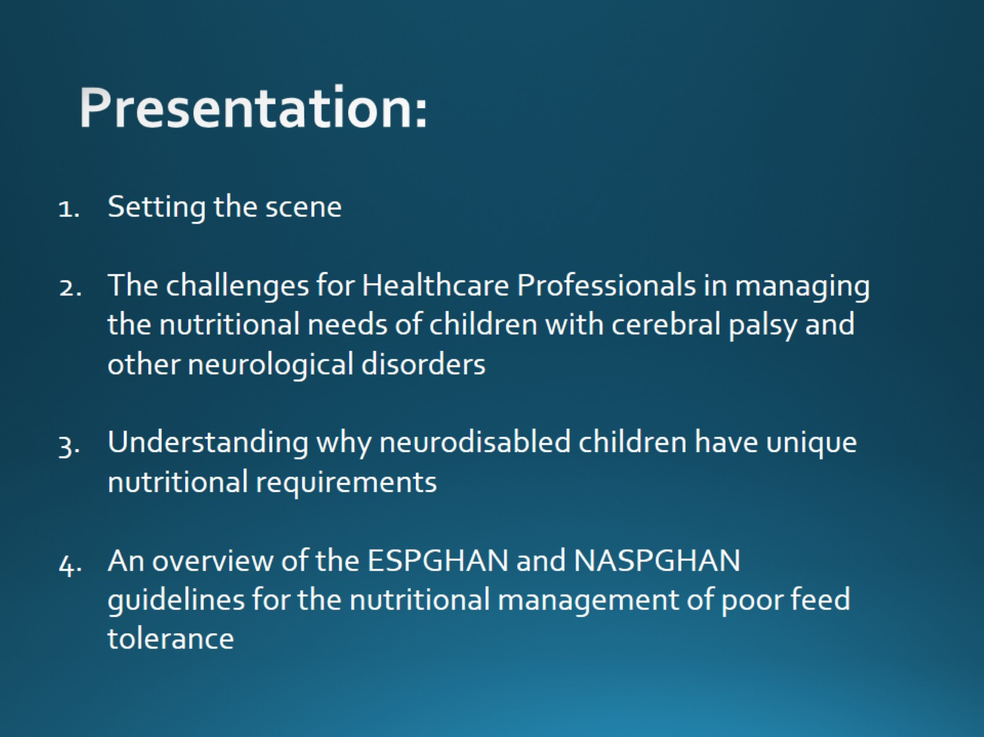
Presentation:

Slide 4
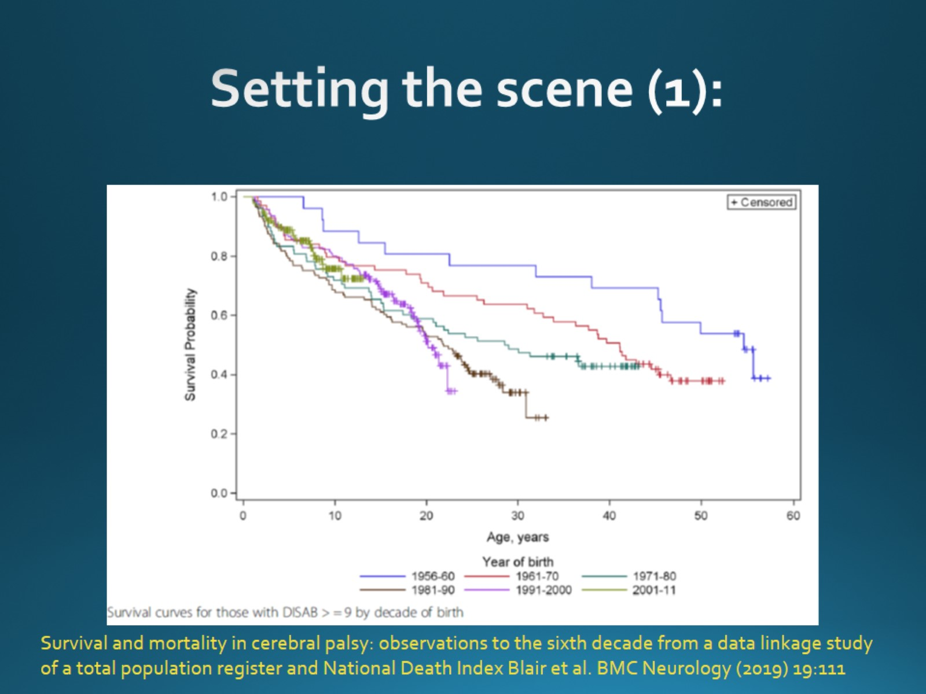
Setting the scene (1):

Slide 5
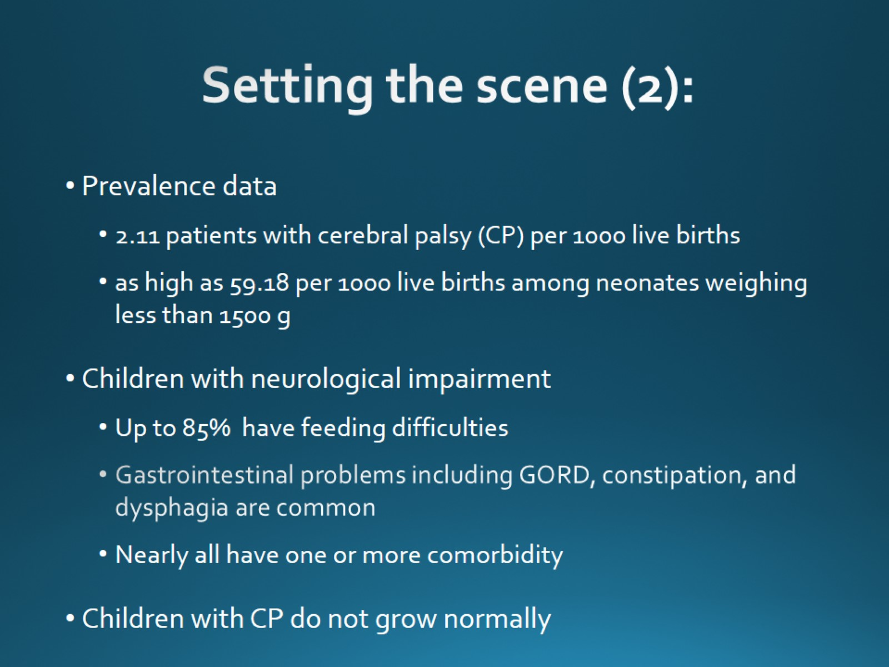
Setting the scene (2):

Slide 6
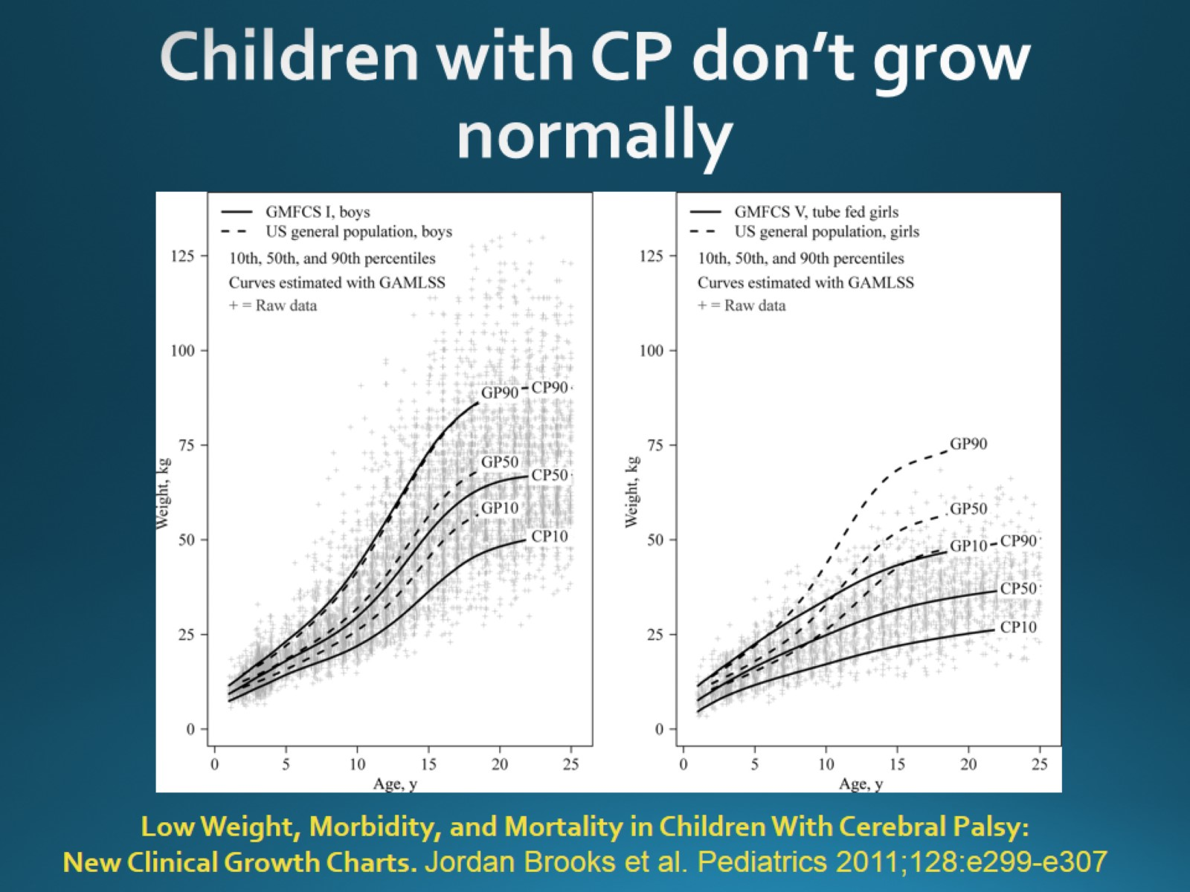
Children with CP don’t grow normally

Slide 7
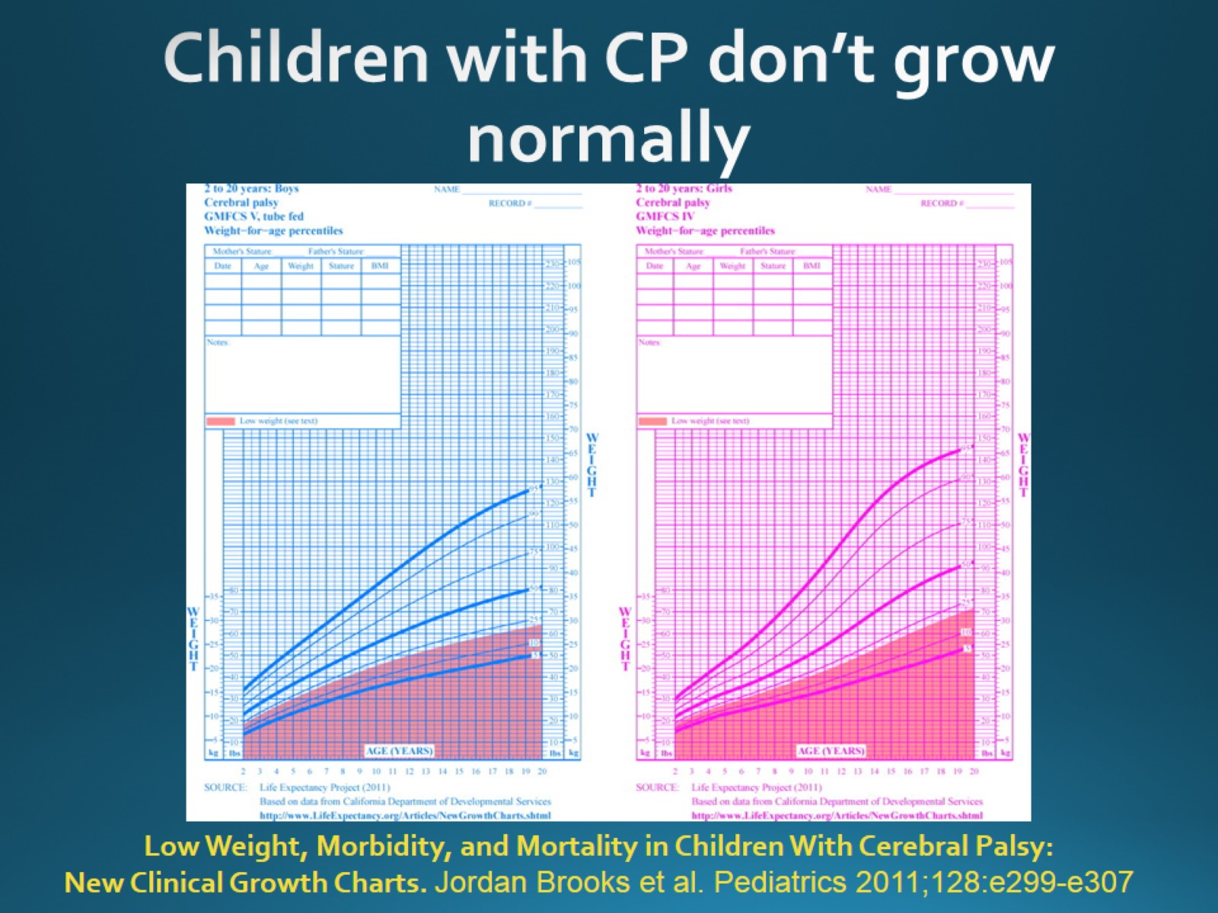
Children with CP don’t grow normally

Slide 8
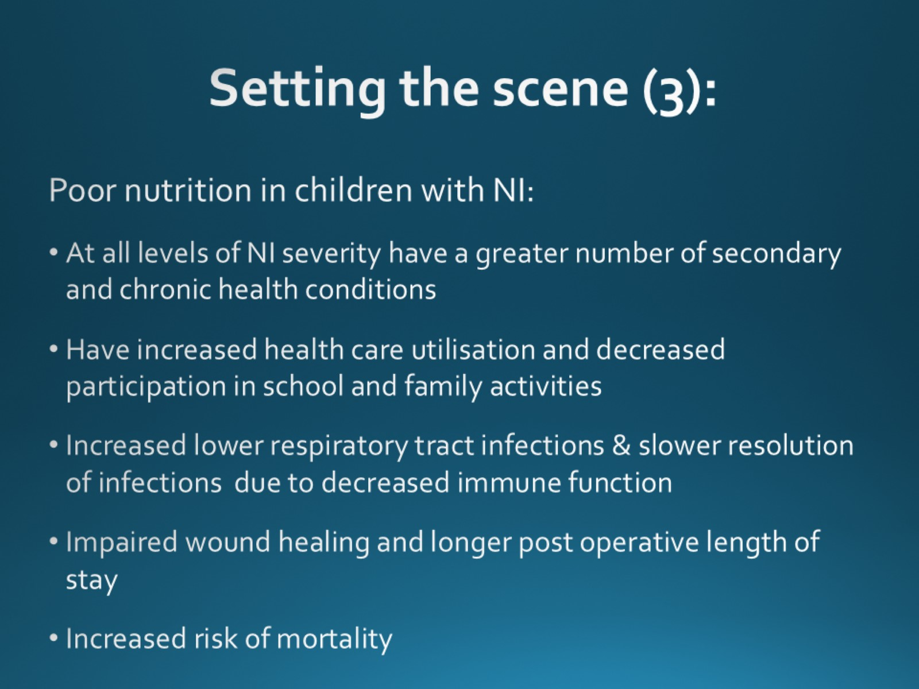
Setting the scene (3):

Slide 9
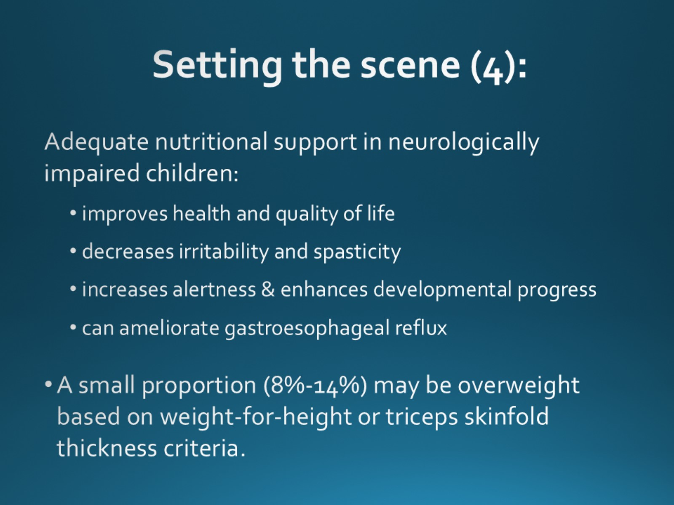
Setting the scene (4):

Slide 10
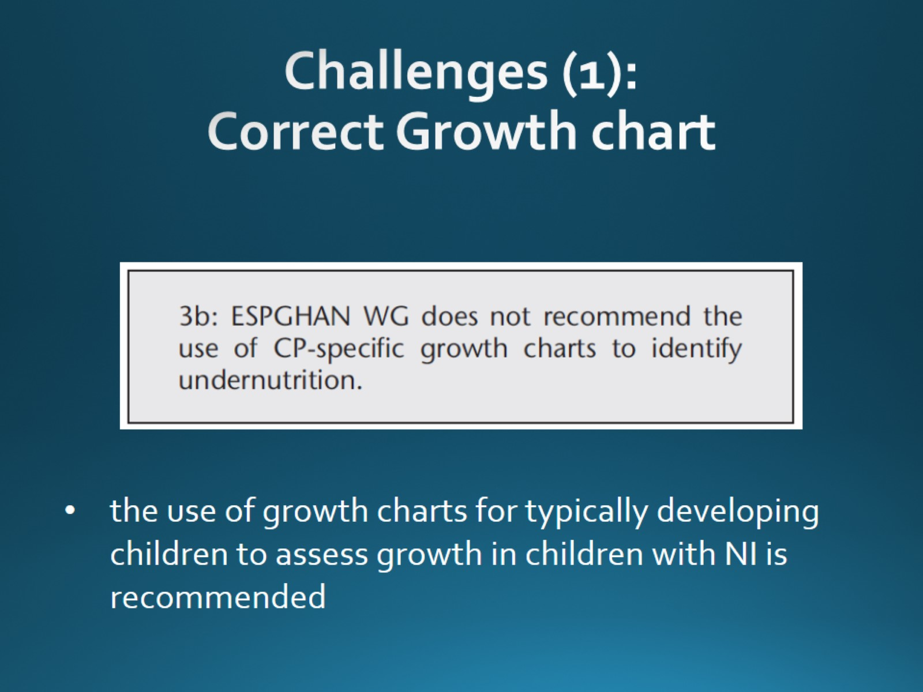
Challenges (1): Correct Growth chart

Slide 11
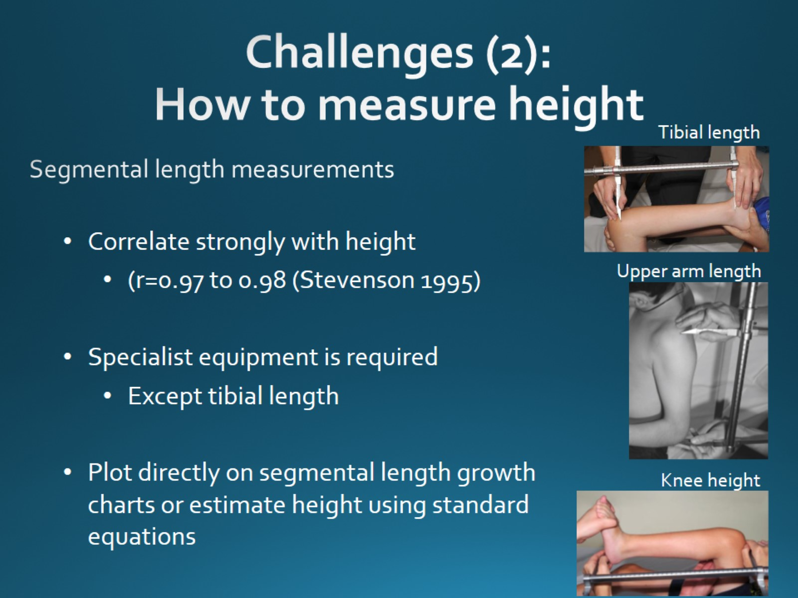
Segmental length measurements

Slide 12


Slide 13
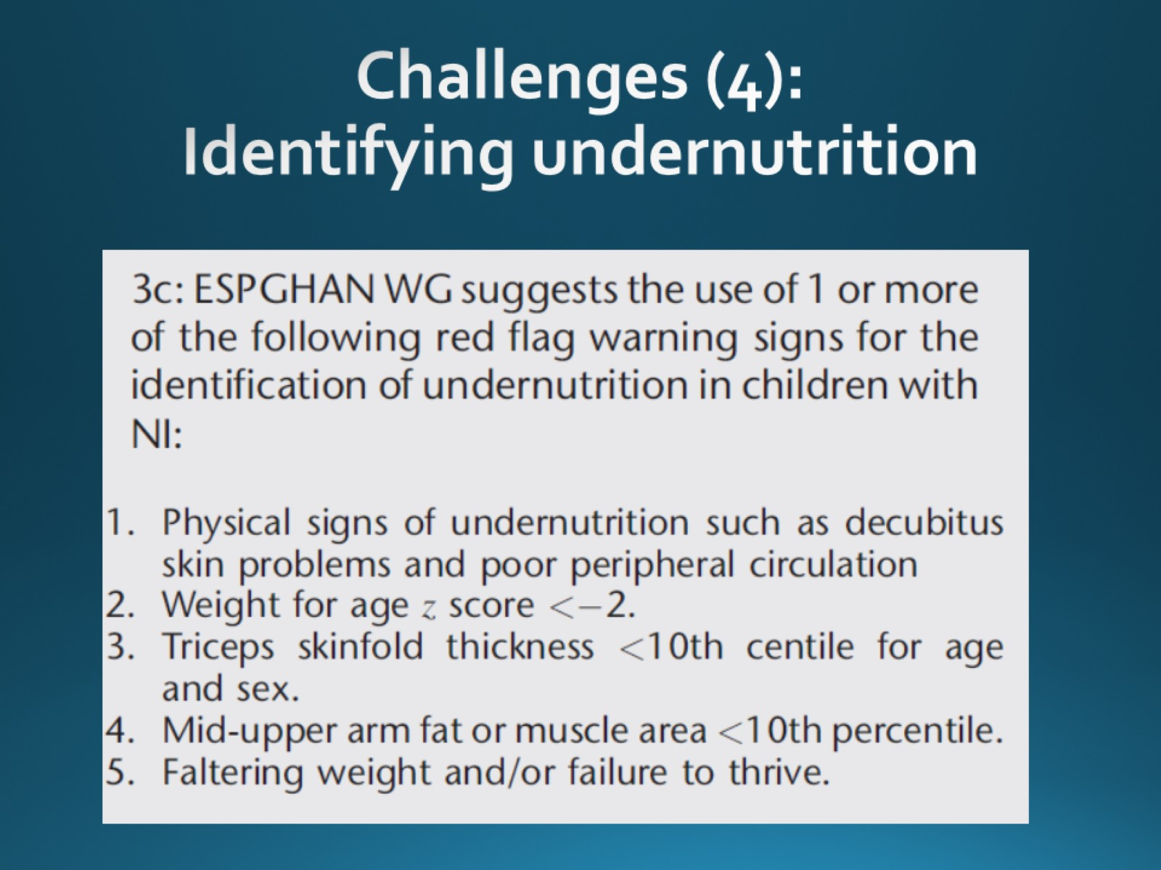

Slide 14
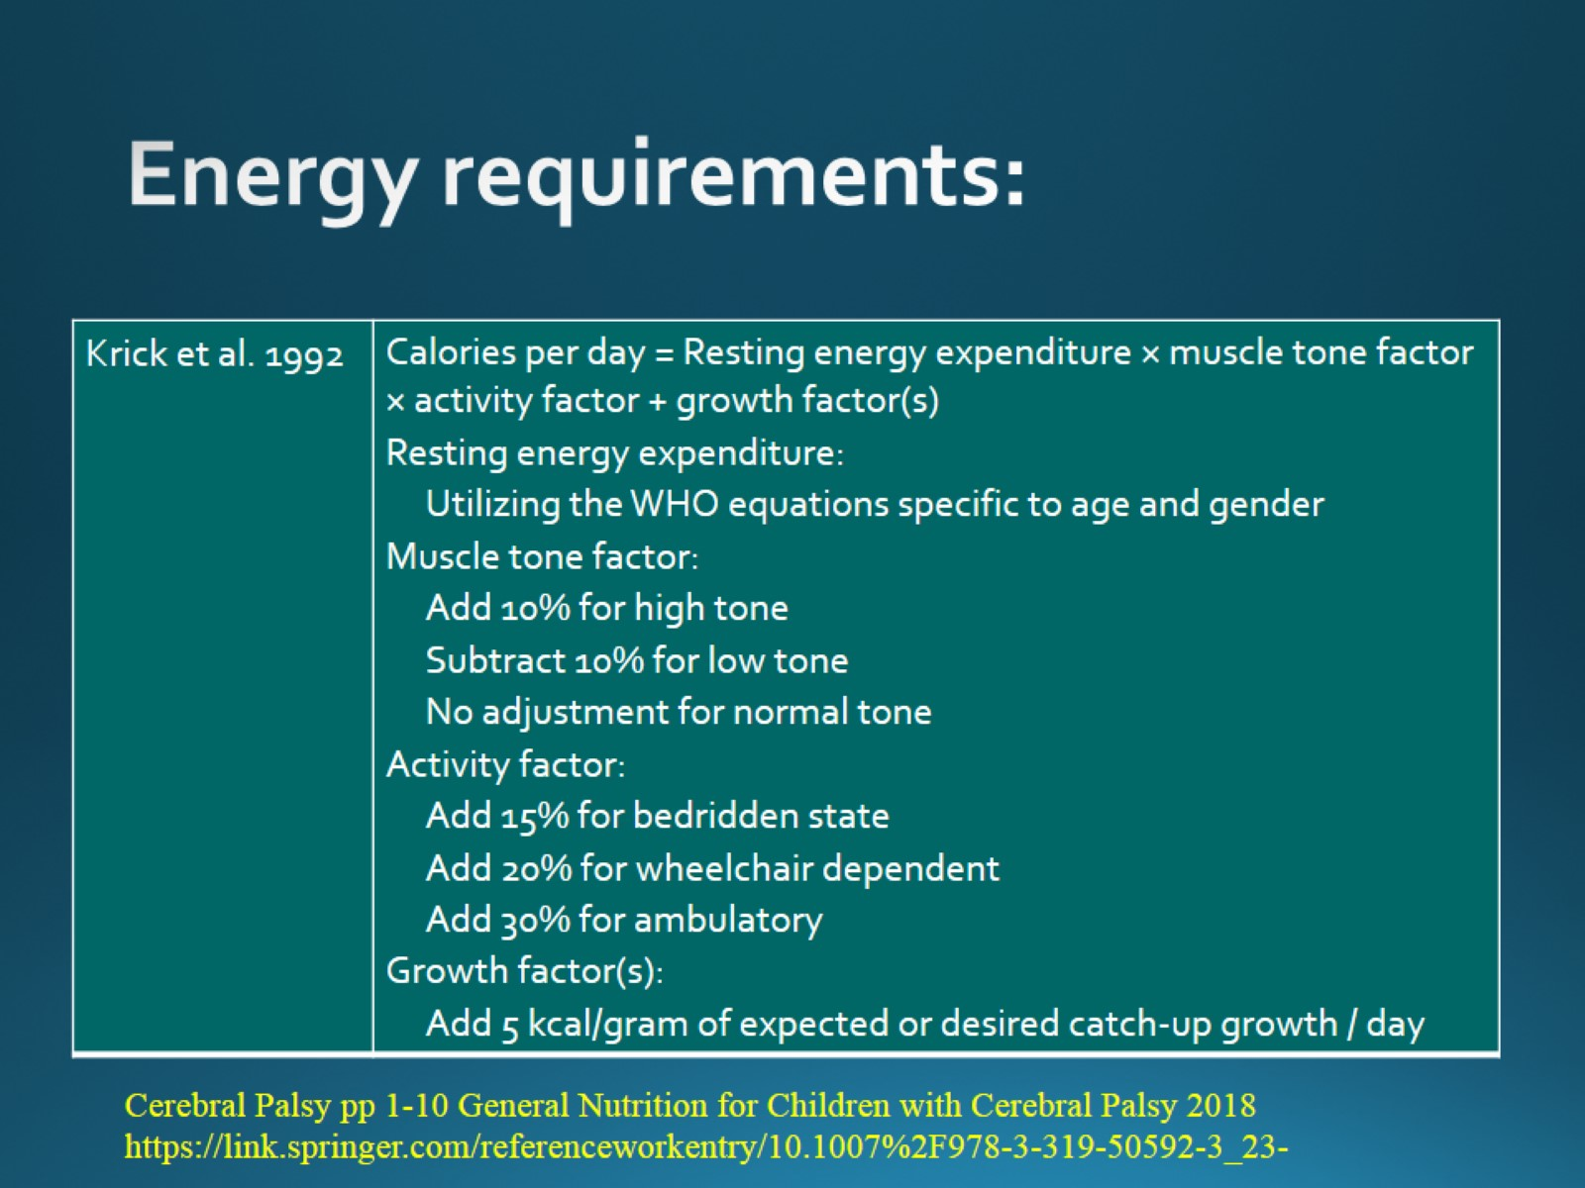
Energy requirements:

Slide 15
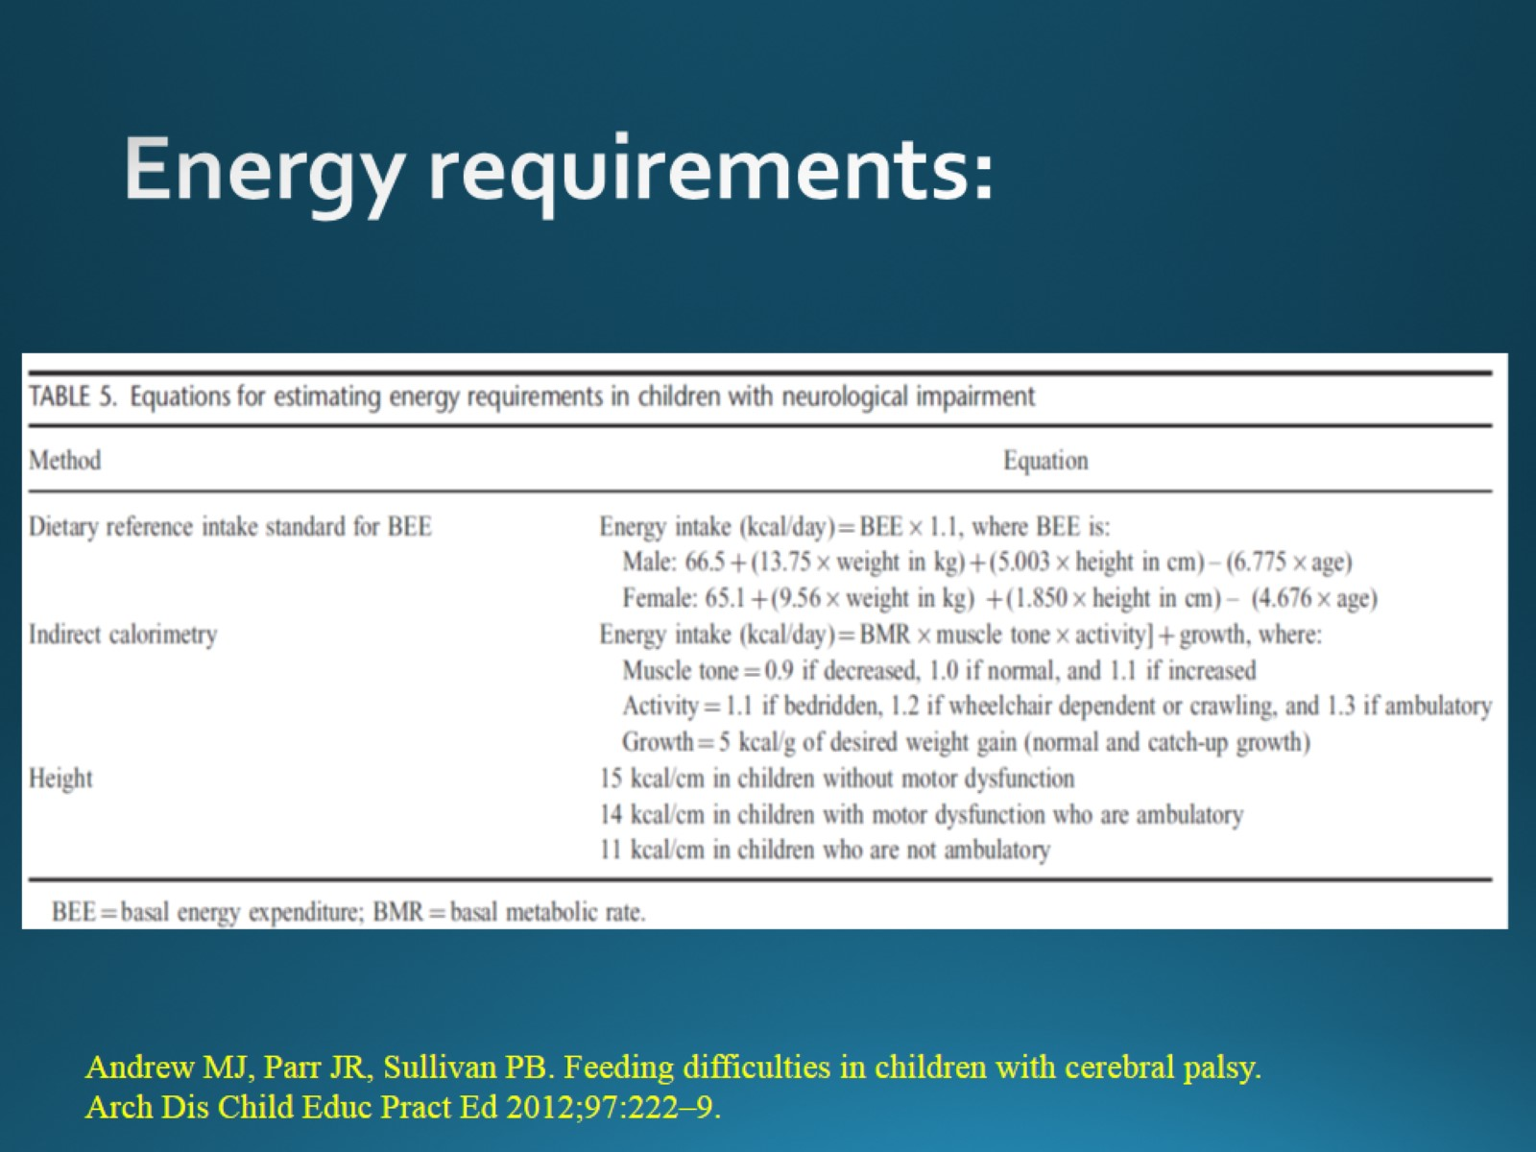
Energy requirements:

Slide 16
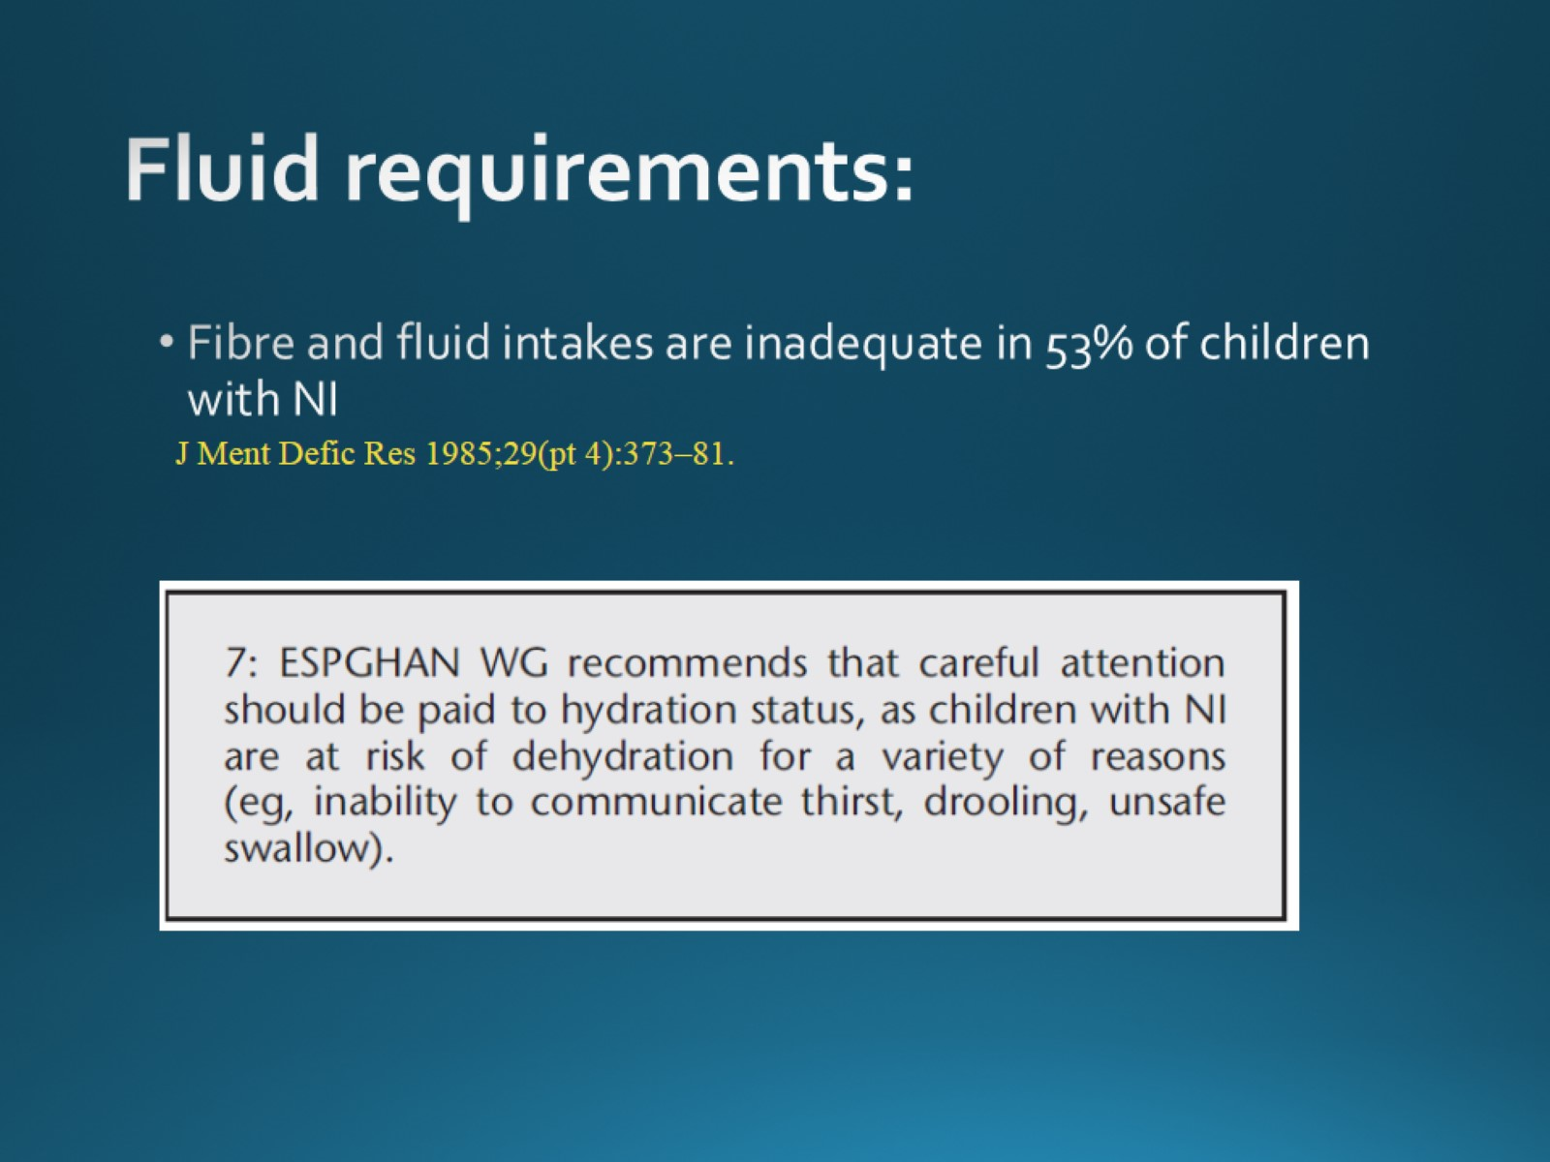
Fluid requirements:

Slide 17
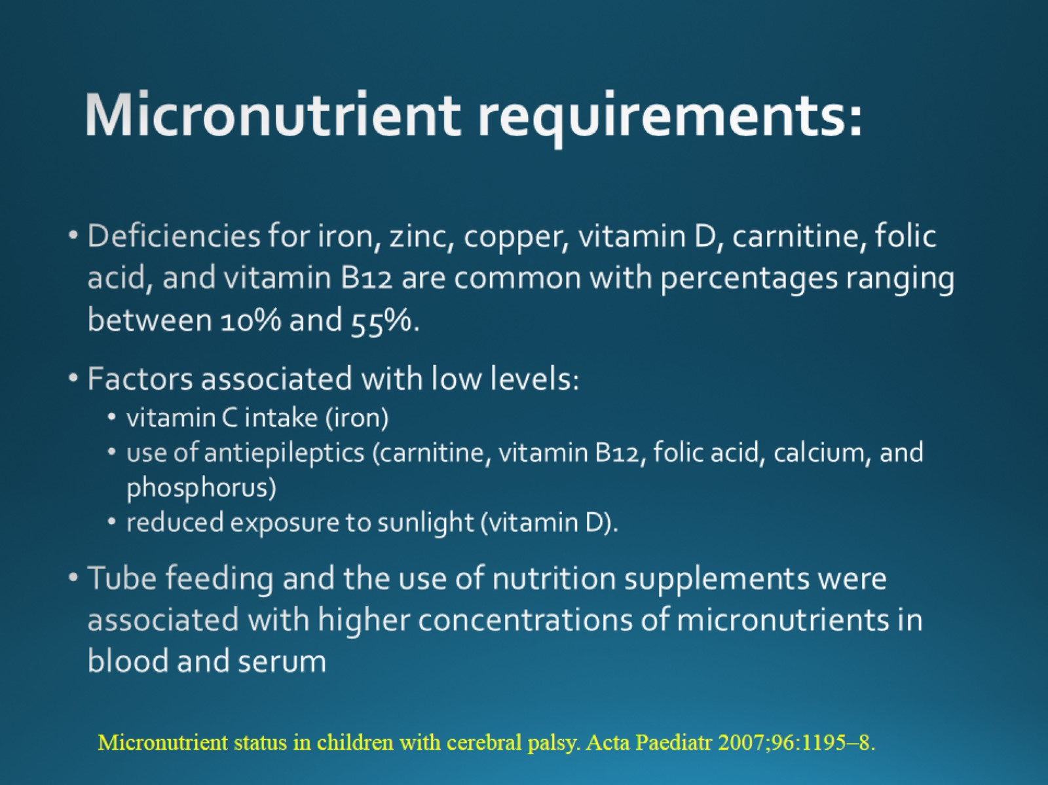
Micronutrient requirements:

Slide 18
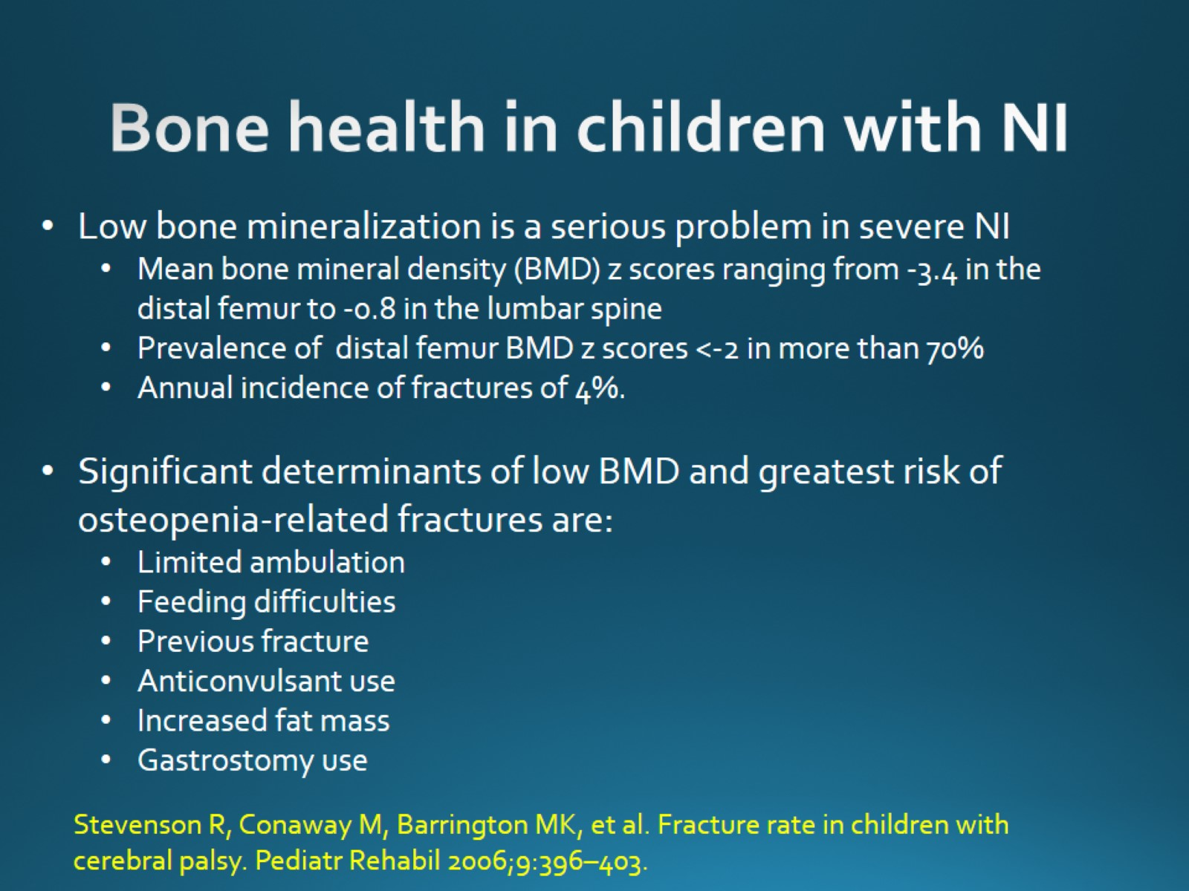
Bone health in children with NI

Slide 19
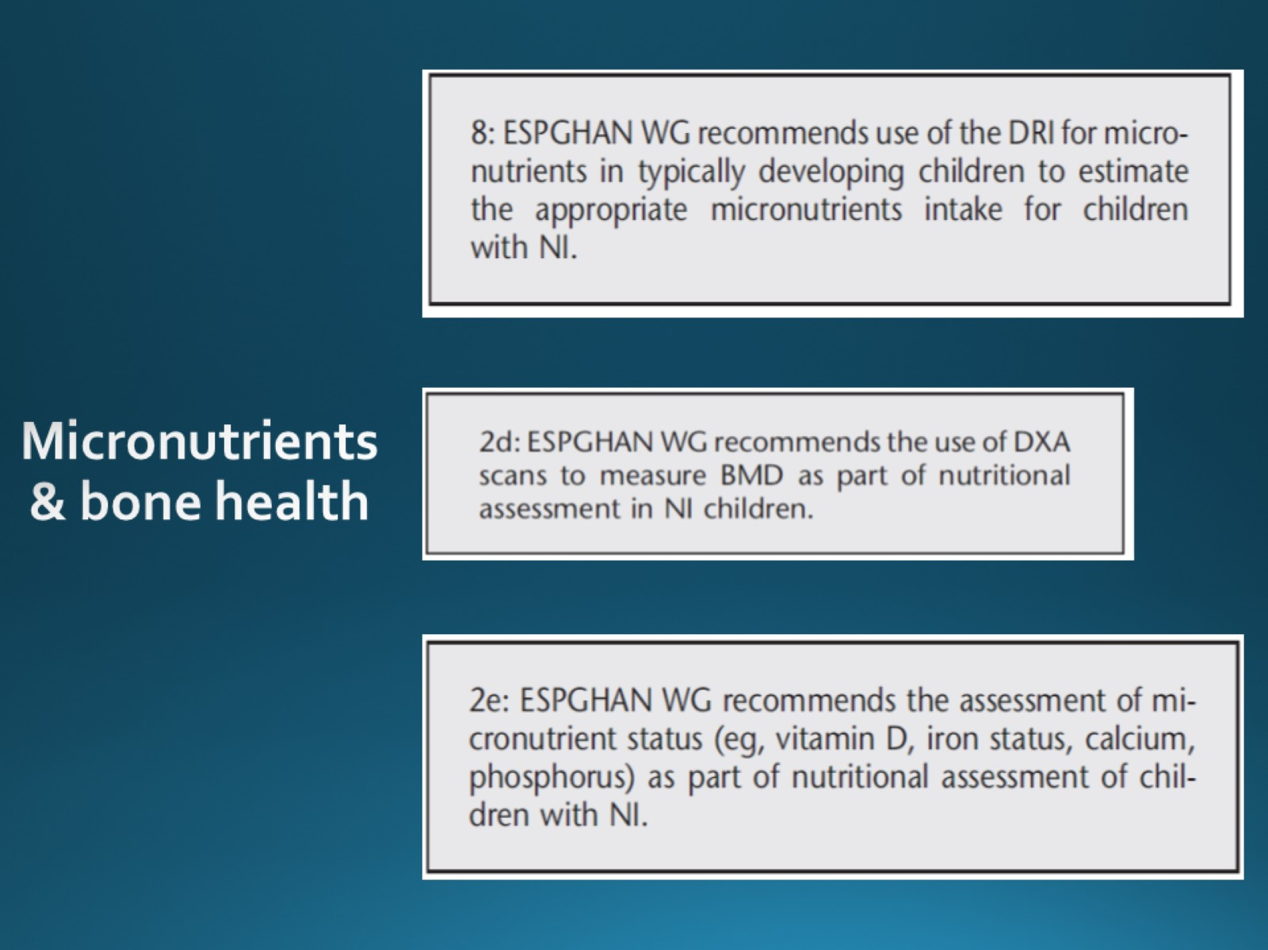

Slide 20
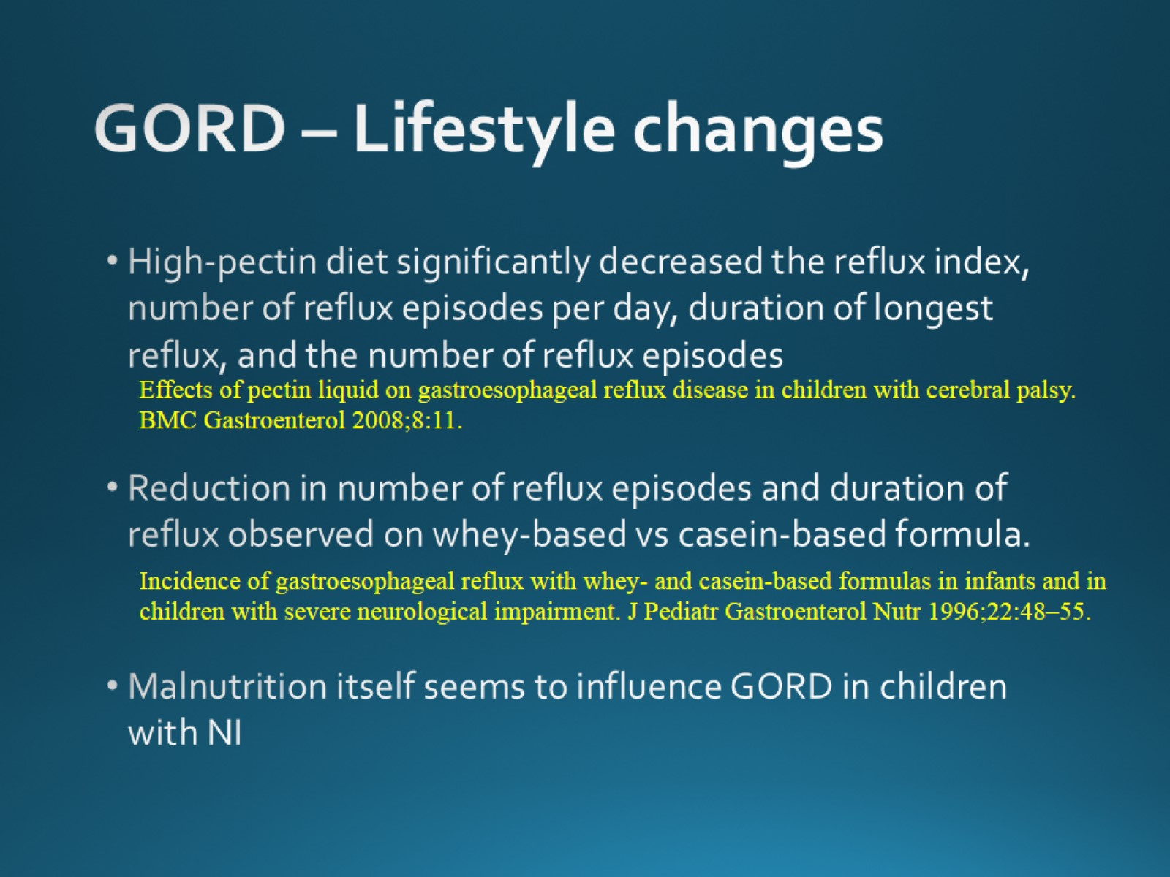
GORD – Lifestyle changes

Slide 21
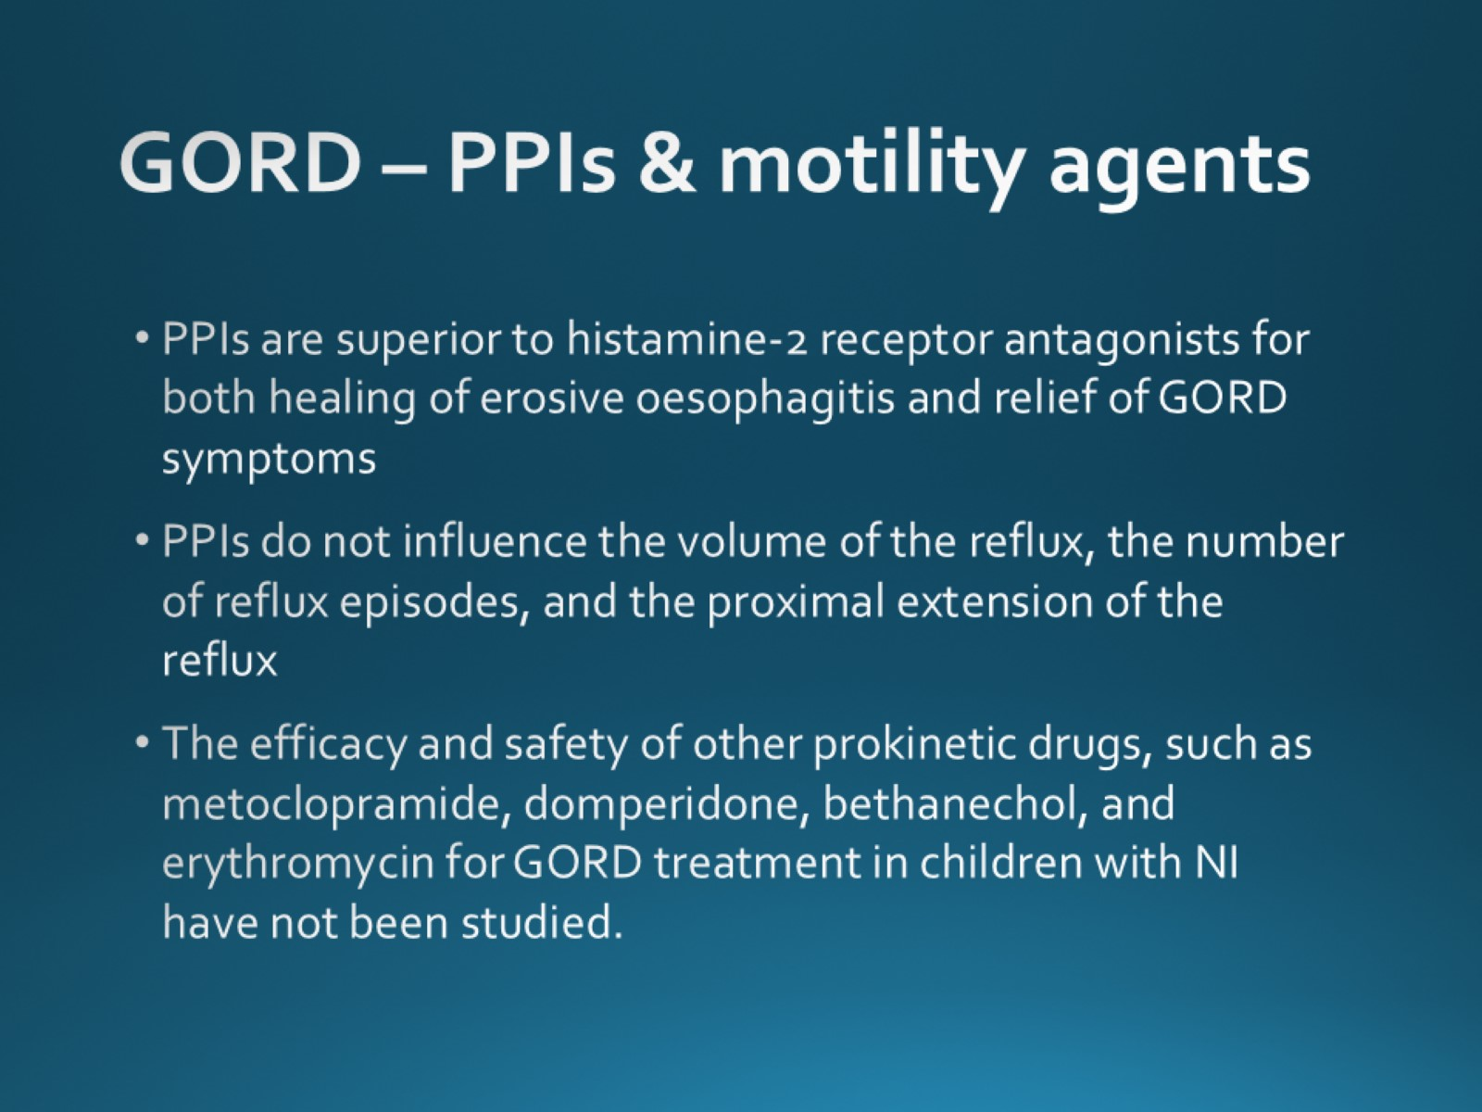
GORD – PPIs & motility agents

Slide 22
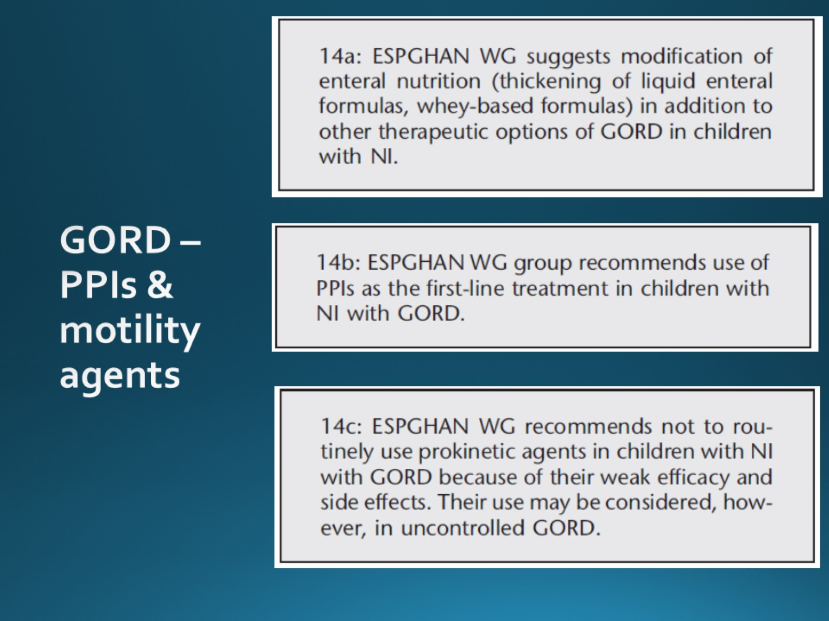

Slide 23
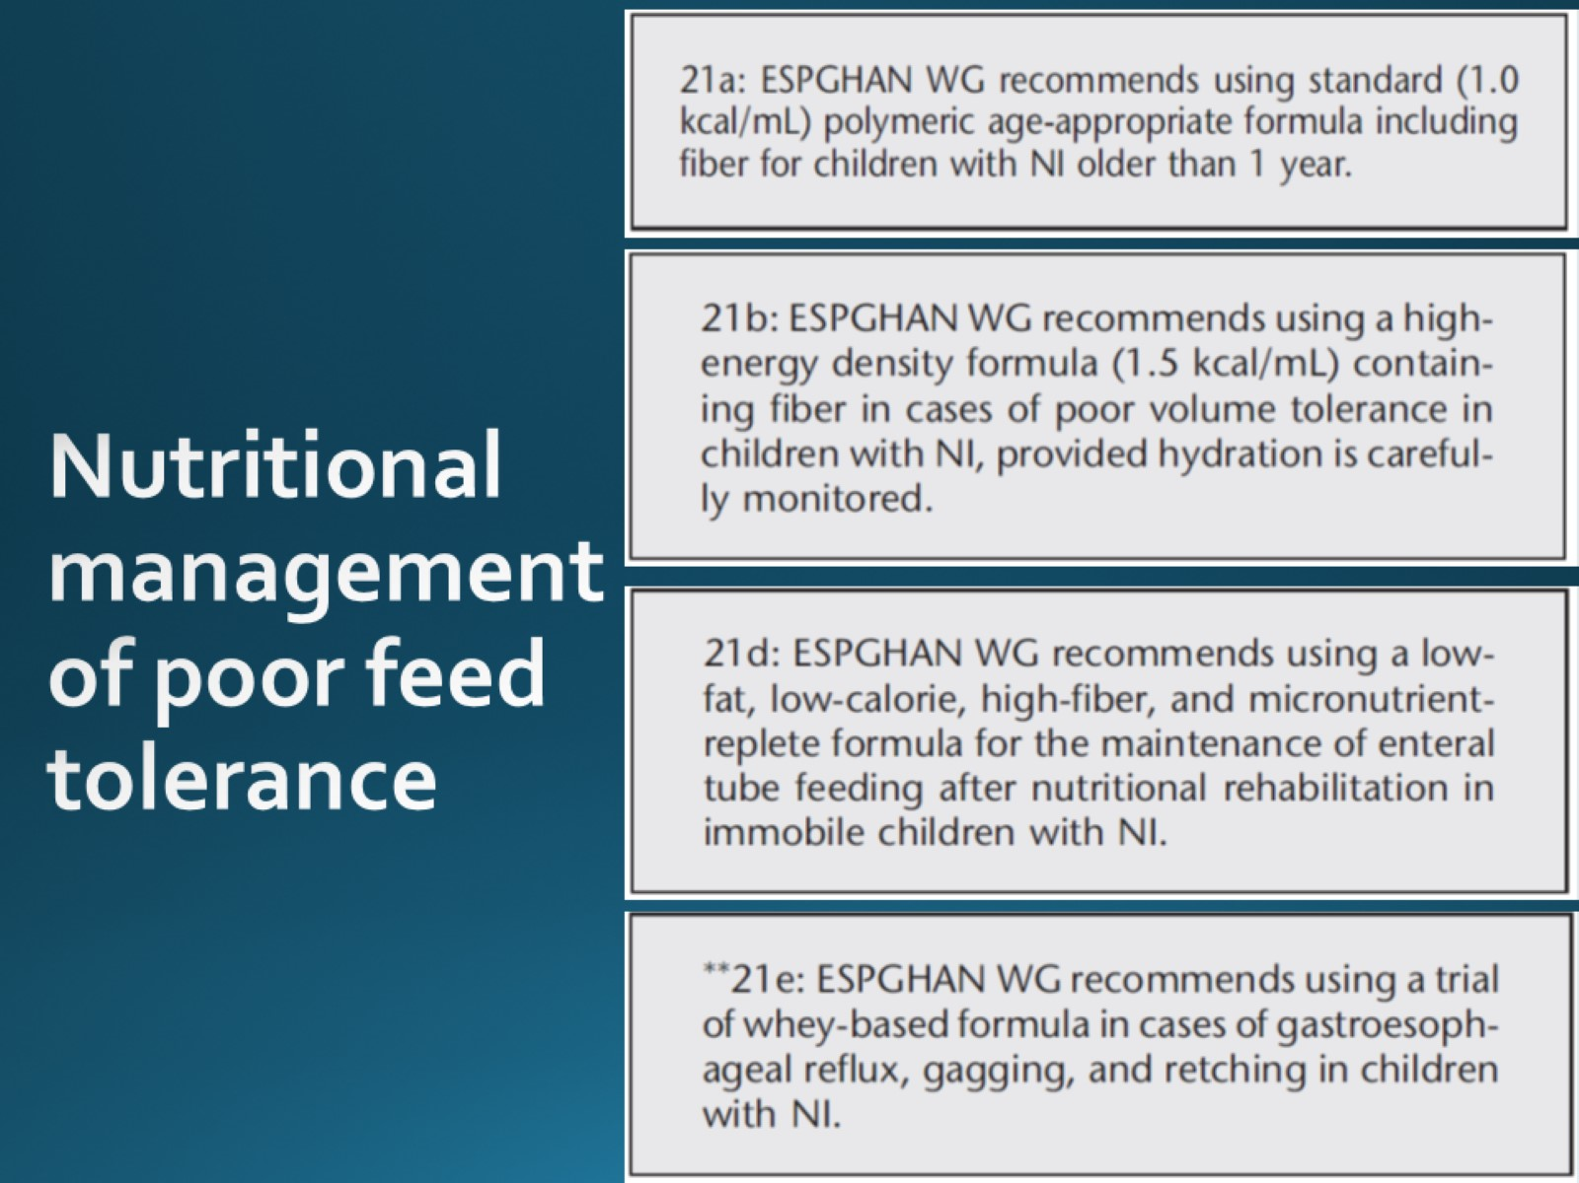

Slide 24
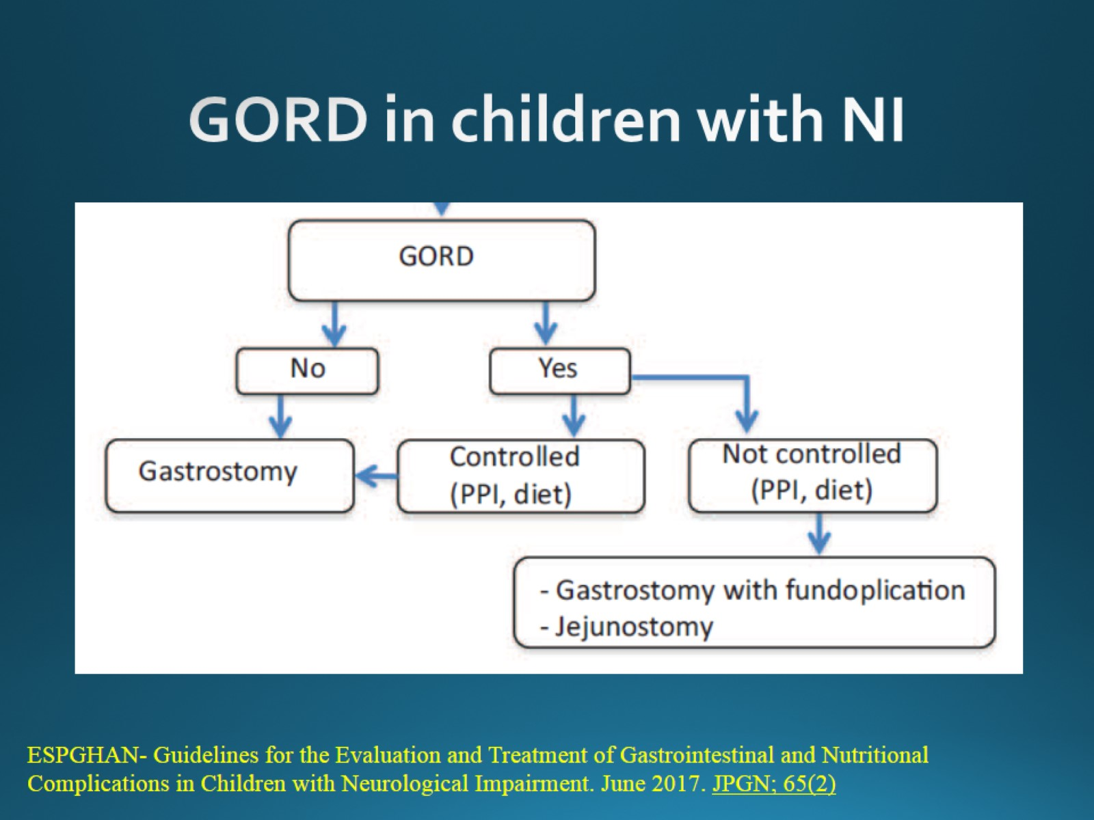
GORD in children with NI

Slide 25
Presentation:

Slide 26

Please welcome Lindsay Rosie

Slide 27

Tube Feeding Children with Low Energy Requirements

Slide 28

Aim

Slide 29
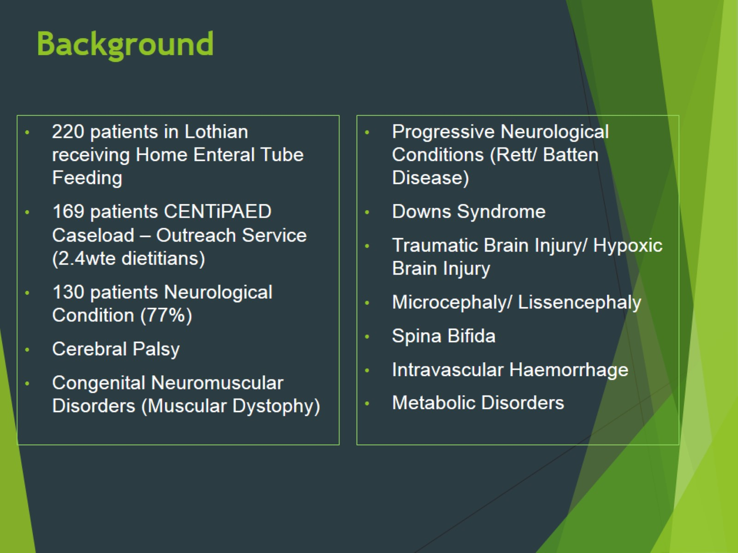
Background

Slide 30
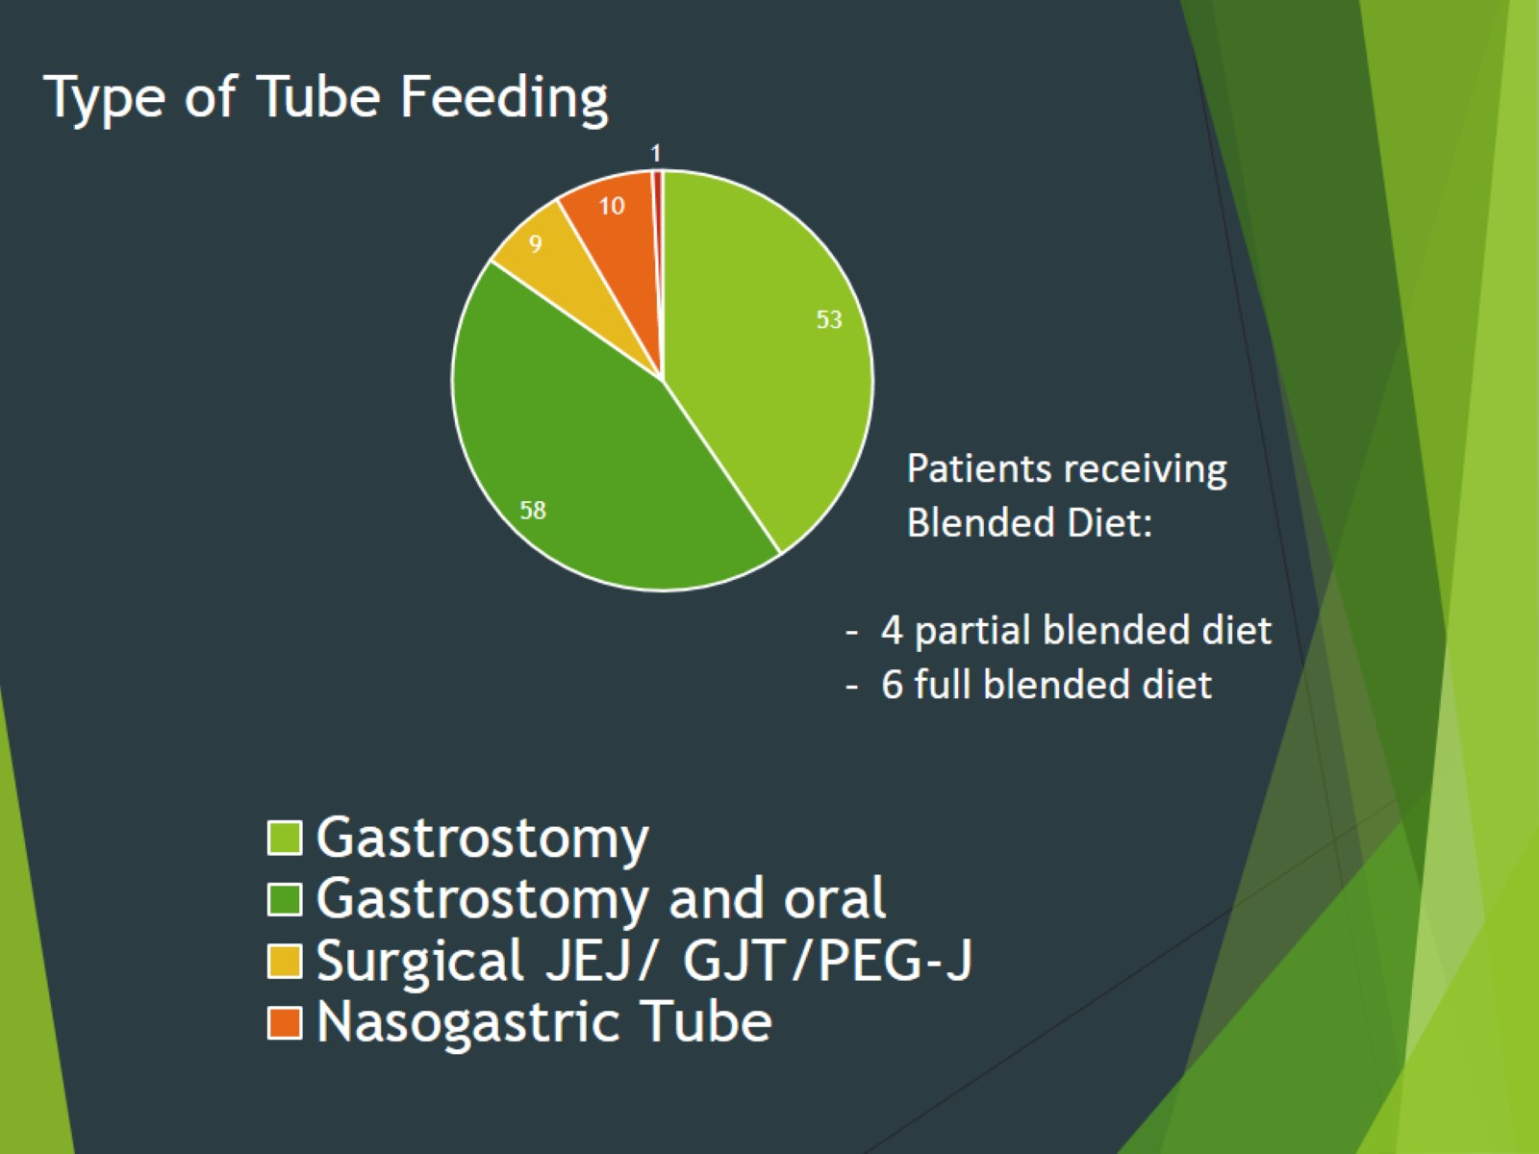

Slide 31
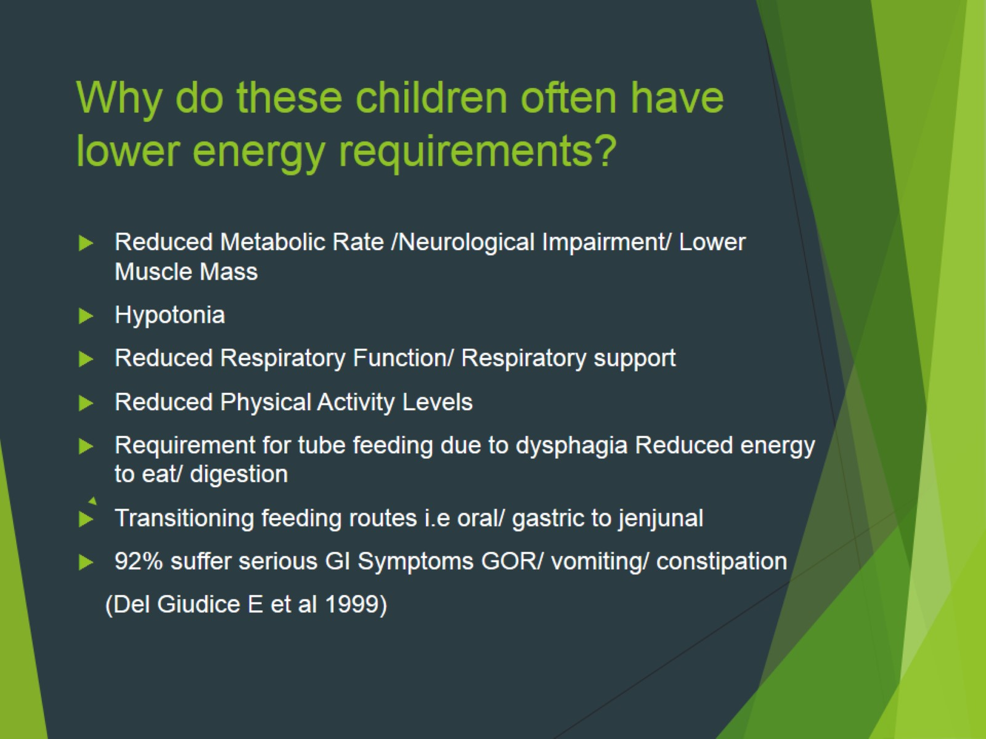
Why do these children often have lower energy requirements?

Slide 32
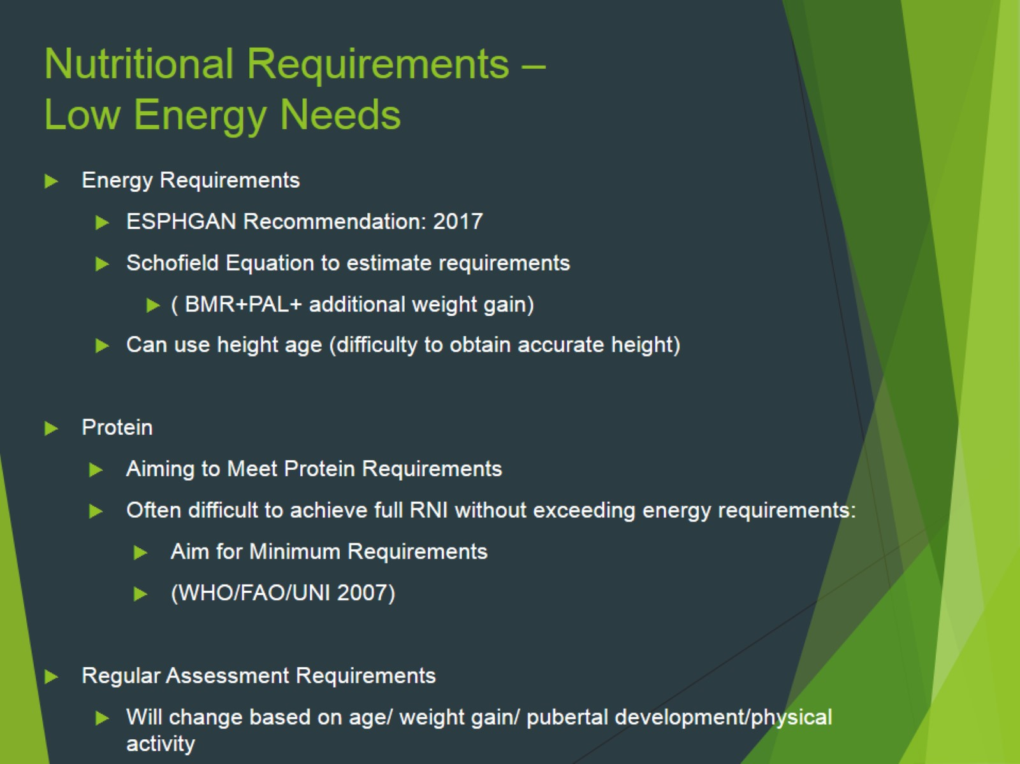
Nutritional Requirements – Low Energy Needs

Slide 33
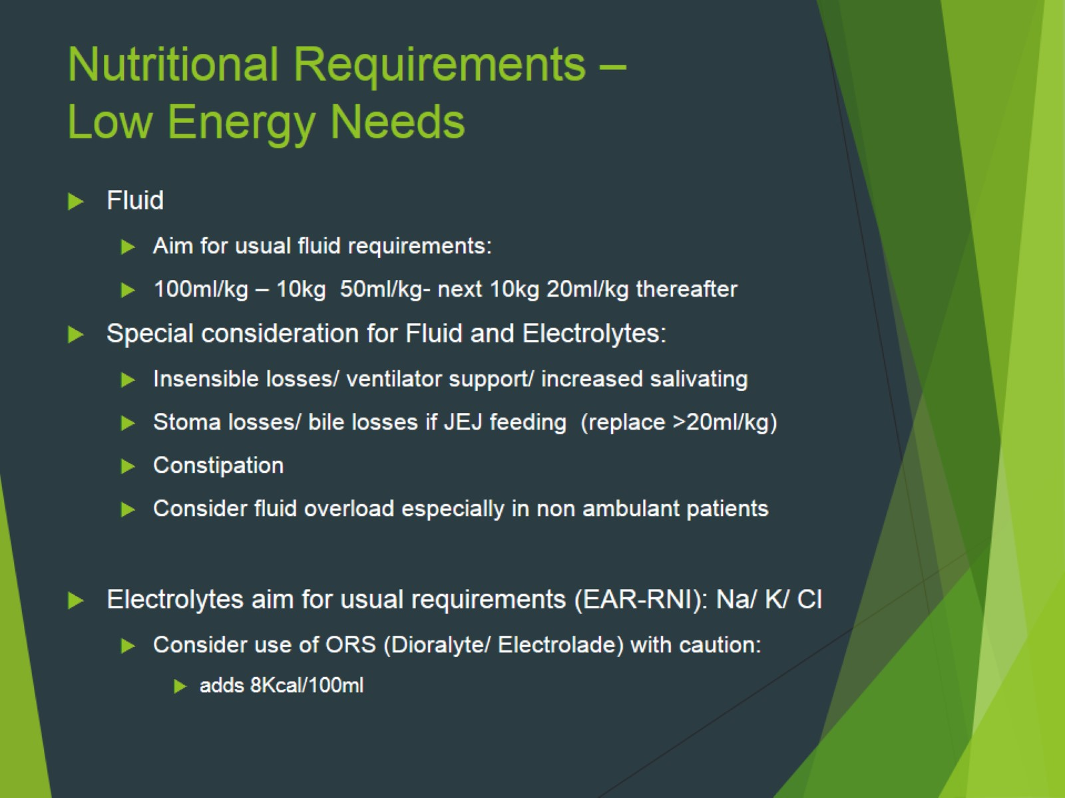
Nutritional Requirements – Low Energy Needs

Slide 34
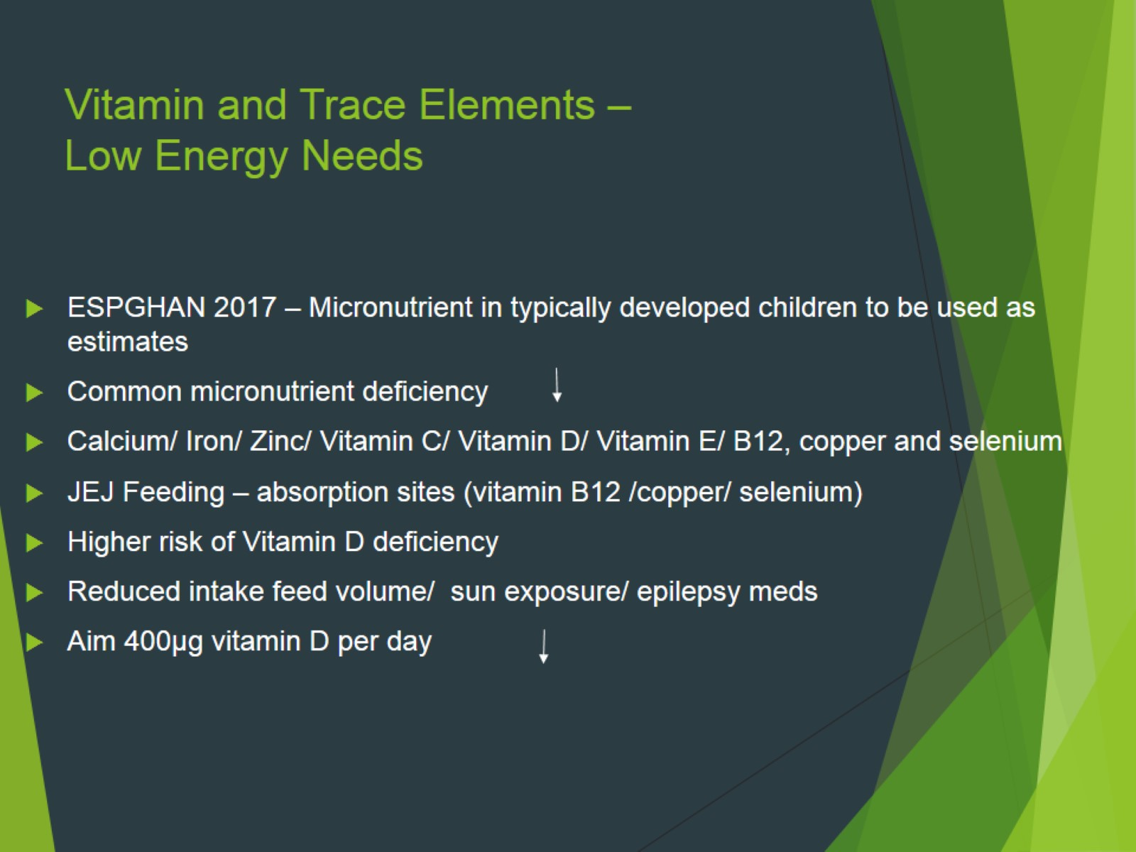
Vitamin and Trace Elements – Low Energy Needs

Slide 35
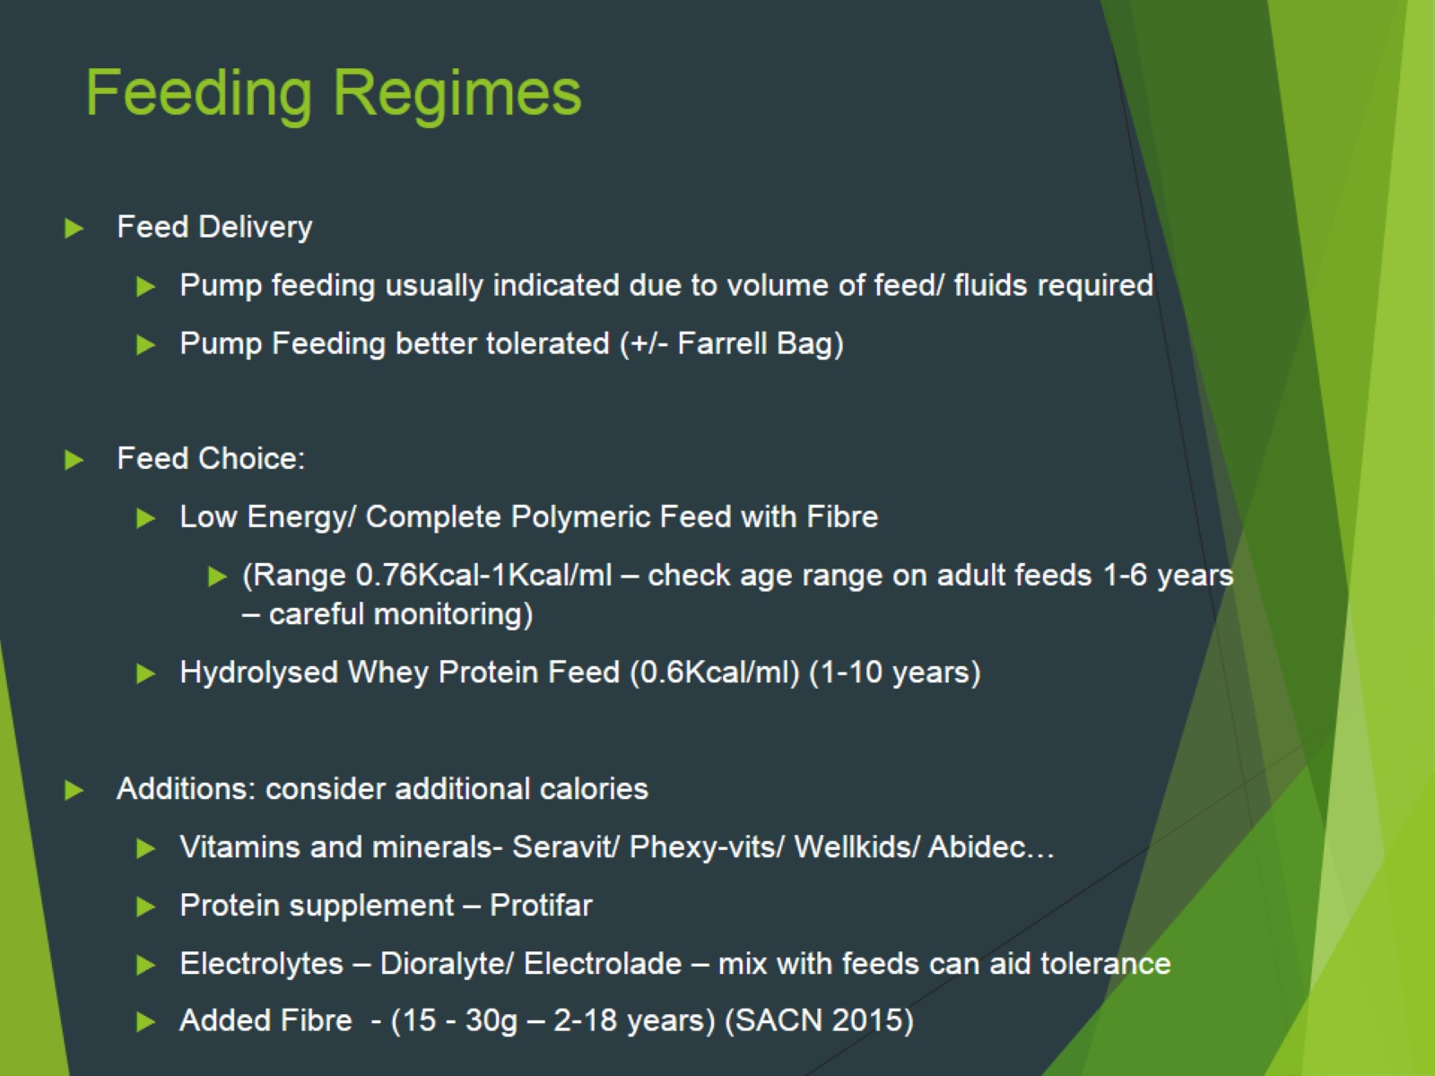
Feeding Regimes

Slide 36
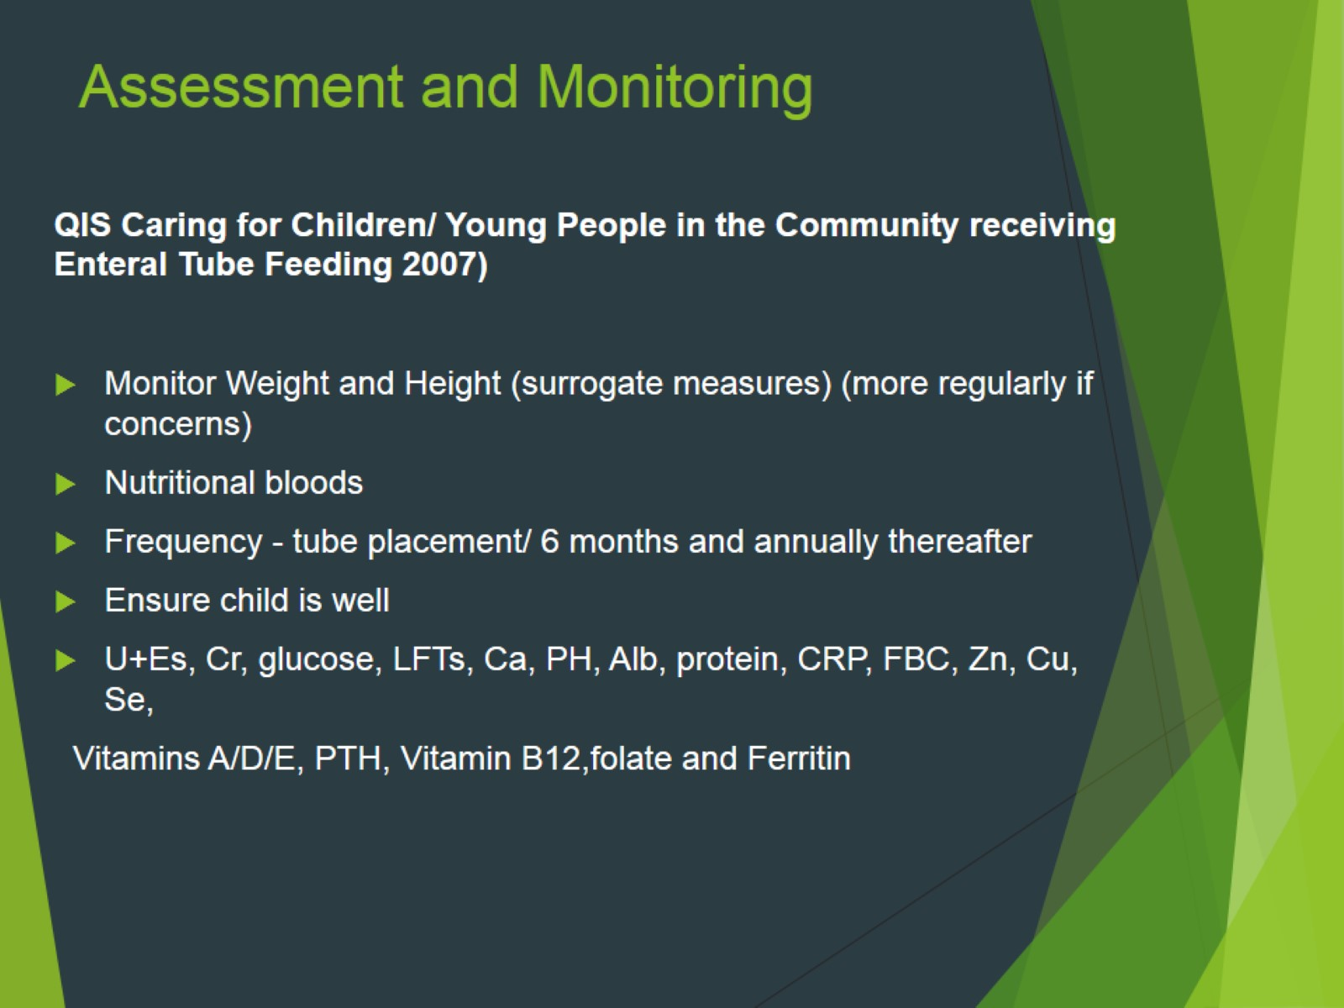
Assessment and Monitoring

Slide 37
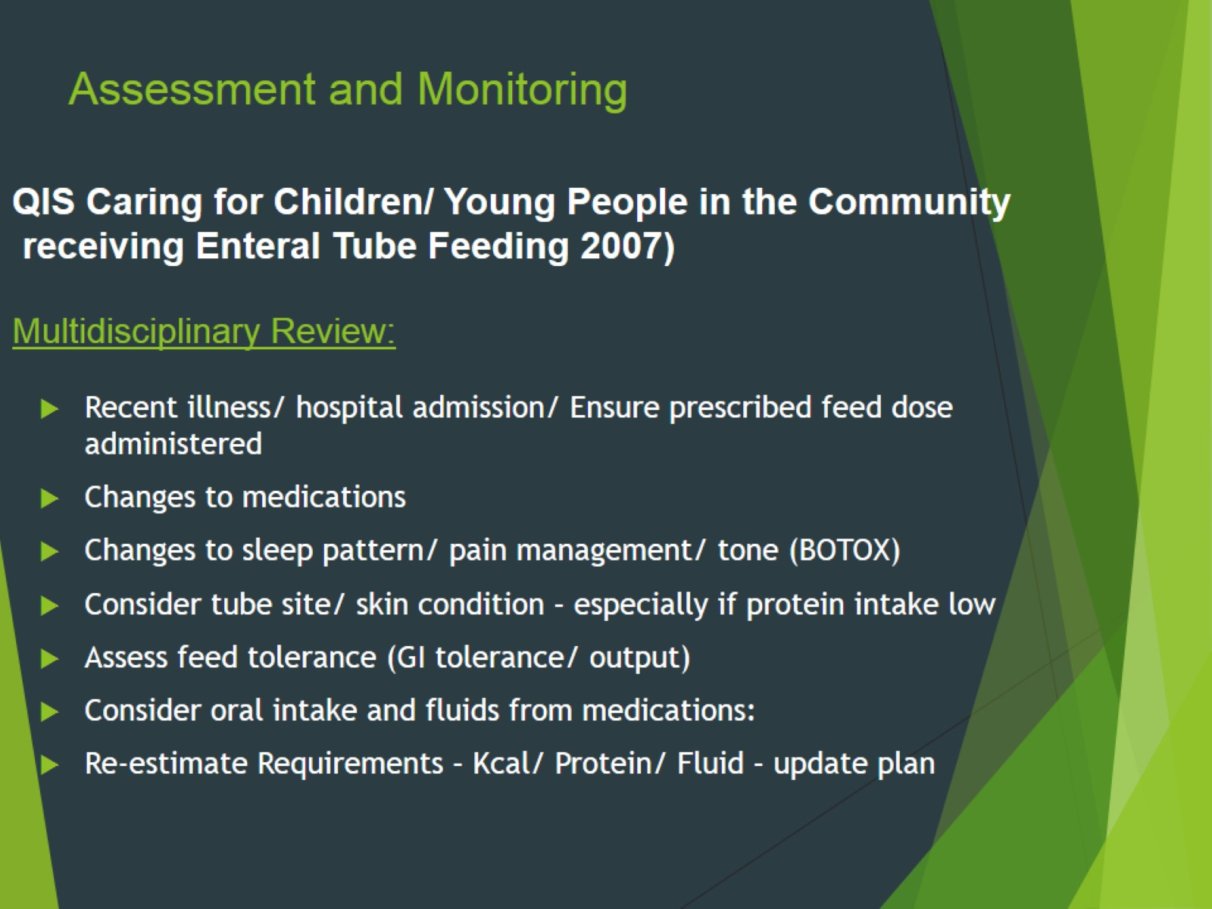
QIS Caring for Children/ Young People in the Community receiving Enteral Tube Feeding 2007) Multidisciplinary Review:

Slide 38

Case Study – Medical Background

Slide 39
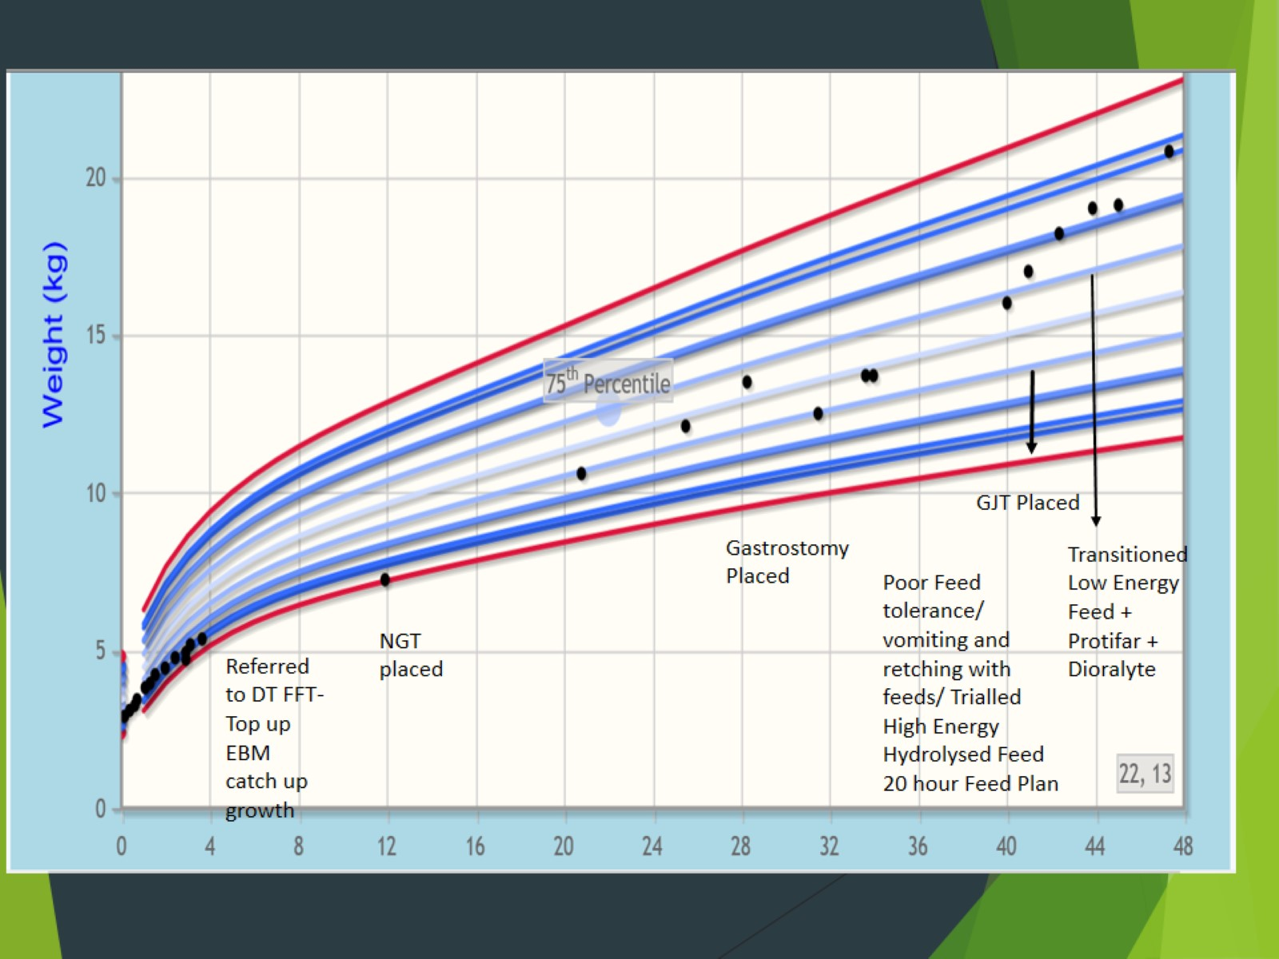

Slide 40
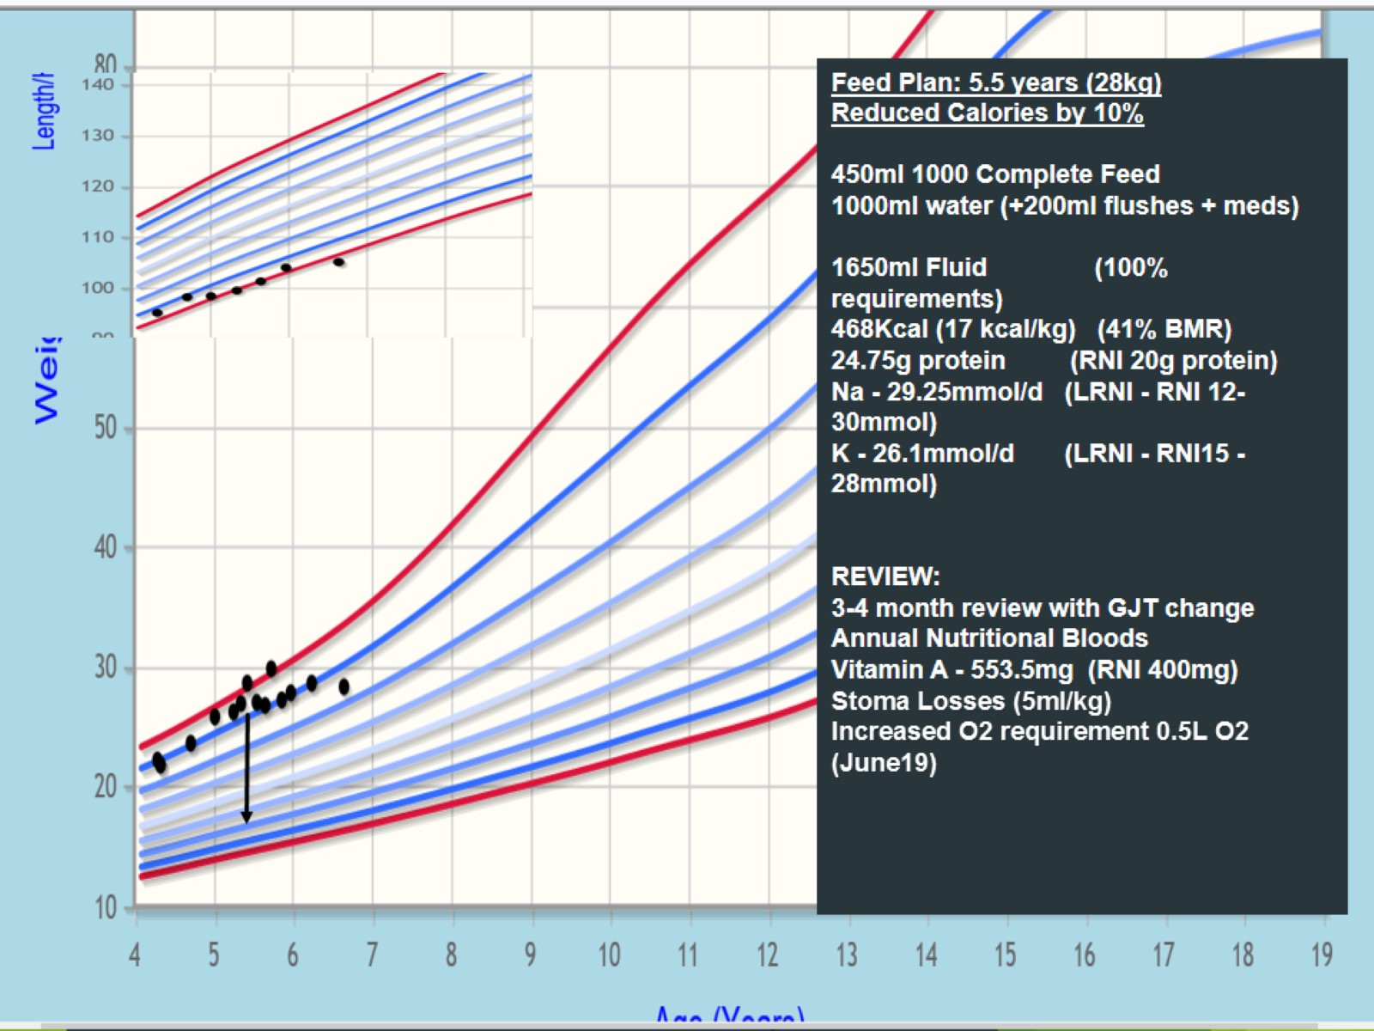

Slide 41
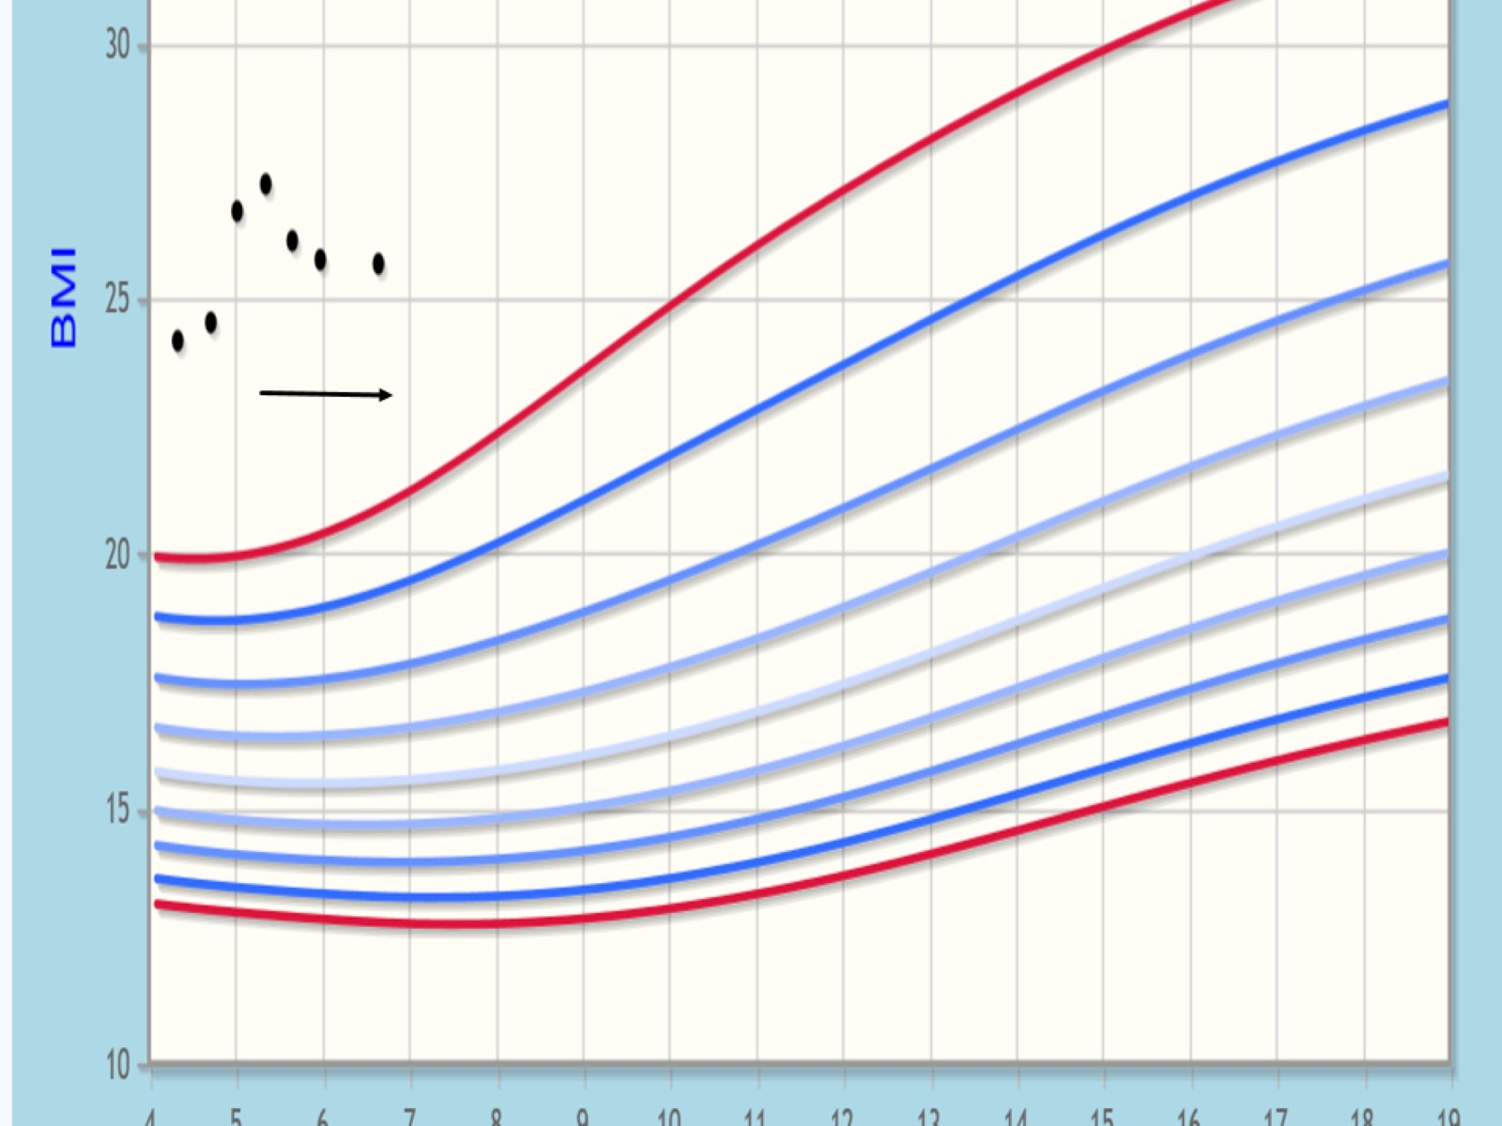

Slide 42
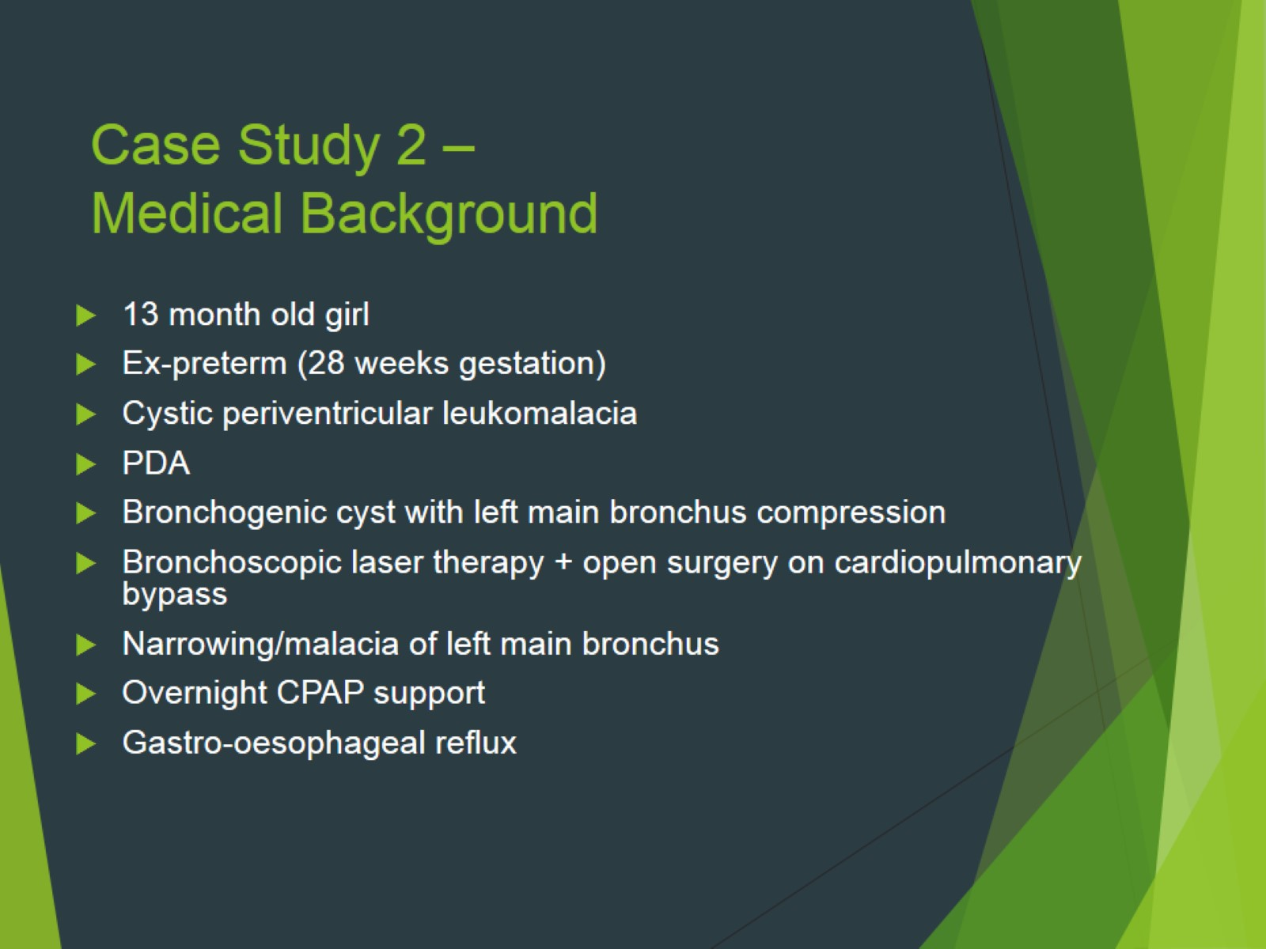
Case Study 2 – Medical Background

Slide 43
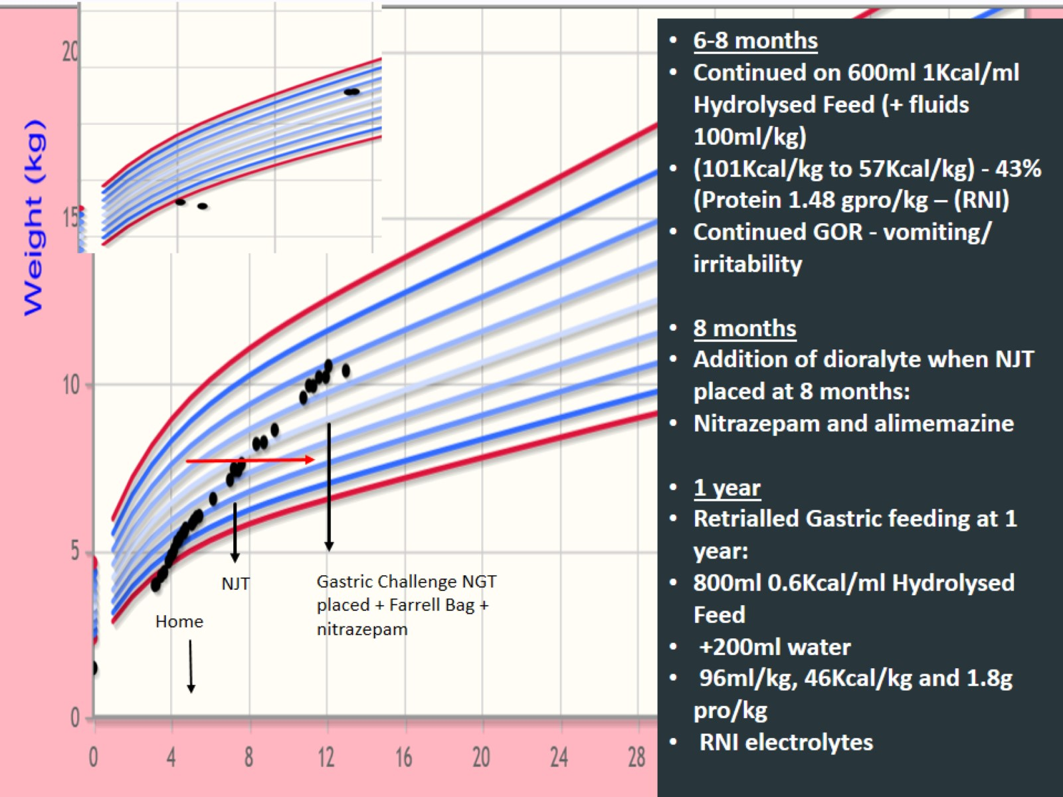

Slide 44
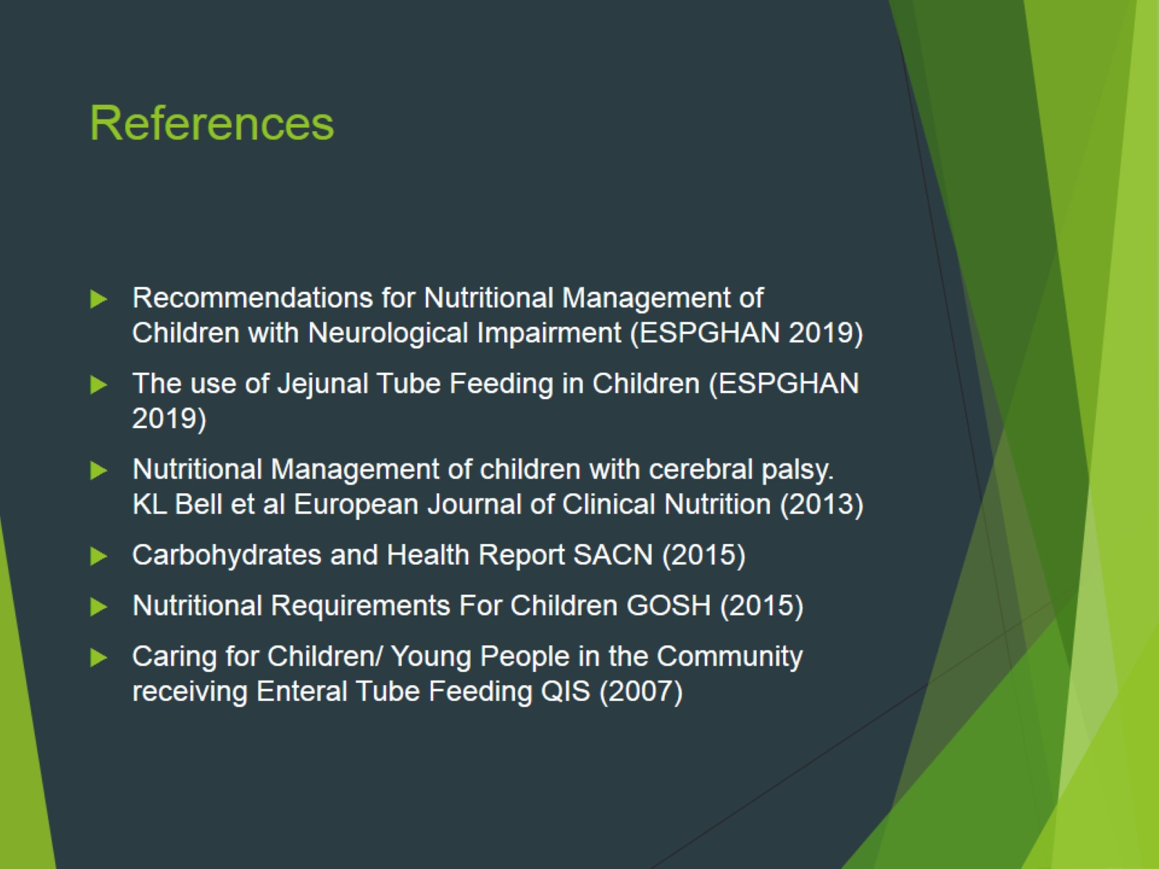
References

Slide 45

Please welcome Jodi Wolff

Slide 46

Practical Tips for Nutrition Assessment of Patients at Home

Slide 47
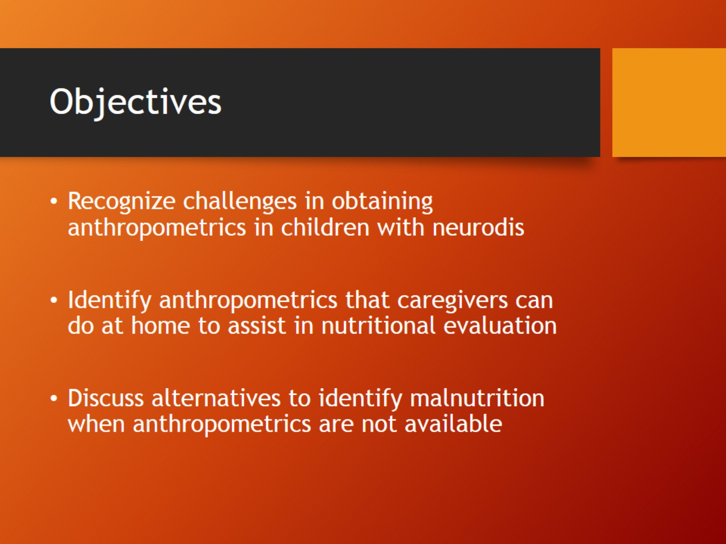
Objectives

Slide 48
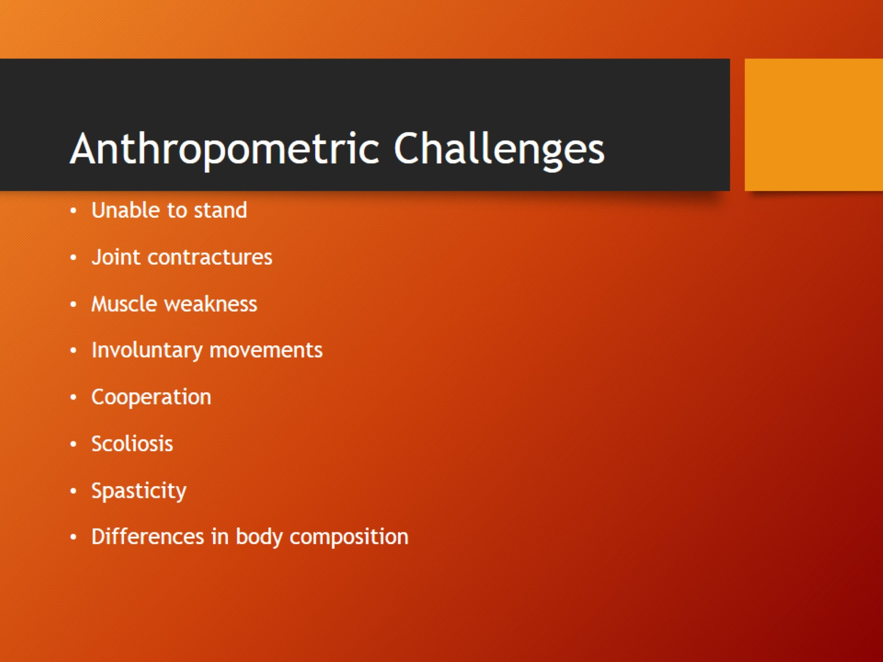
Anthropometric Challenges

Slide 49
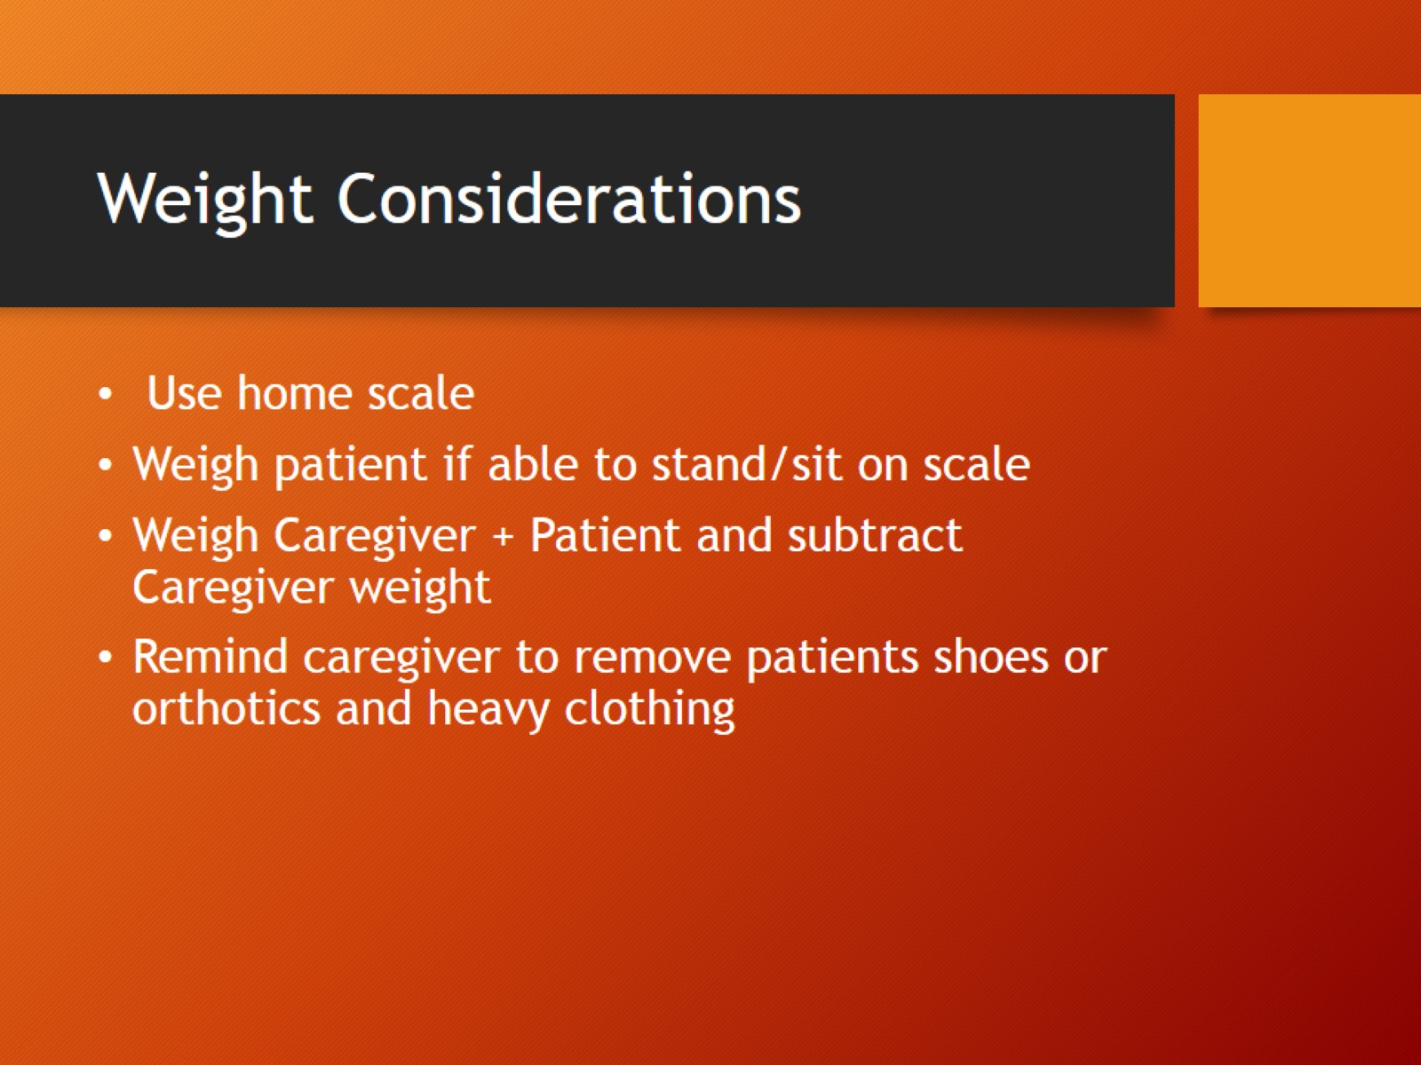
Weight Considerations

Slide 50
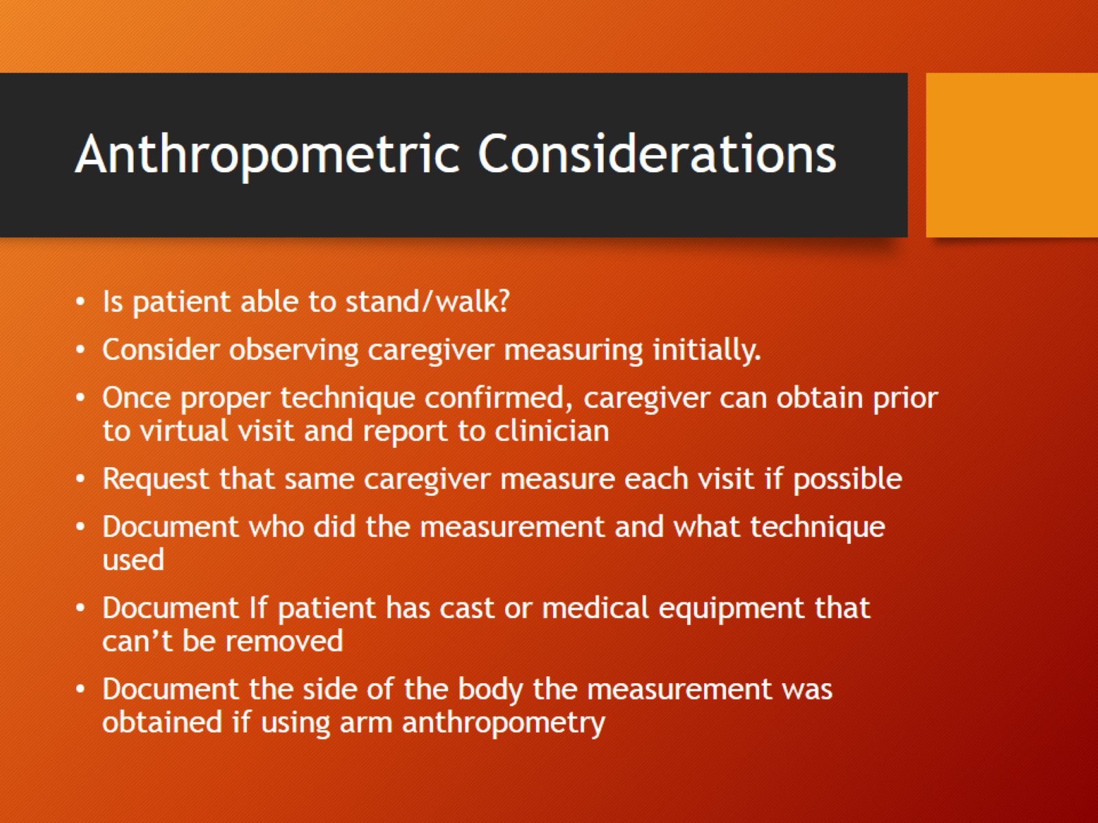
Anthropometric Considerations

Slide 51
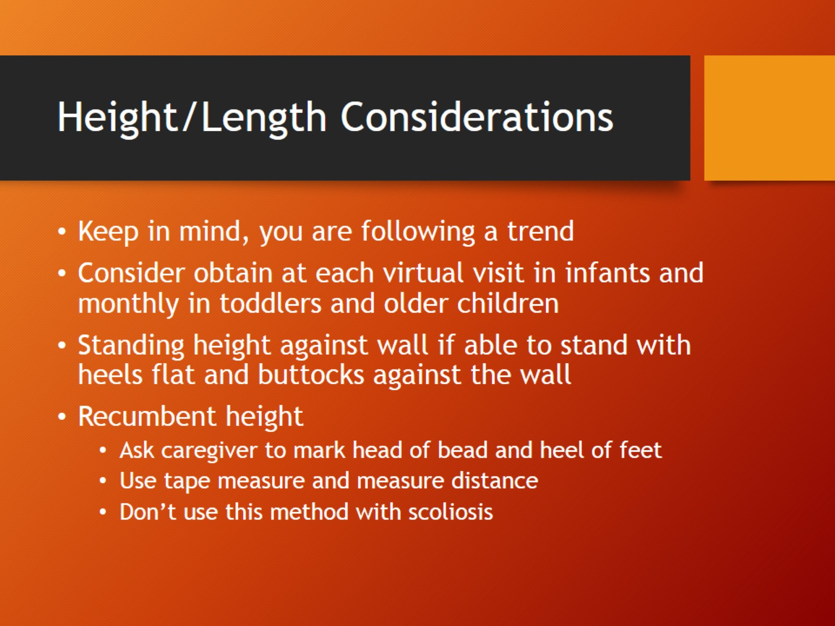
Height/Length Considerations

Slide 52
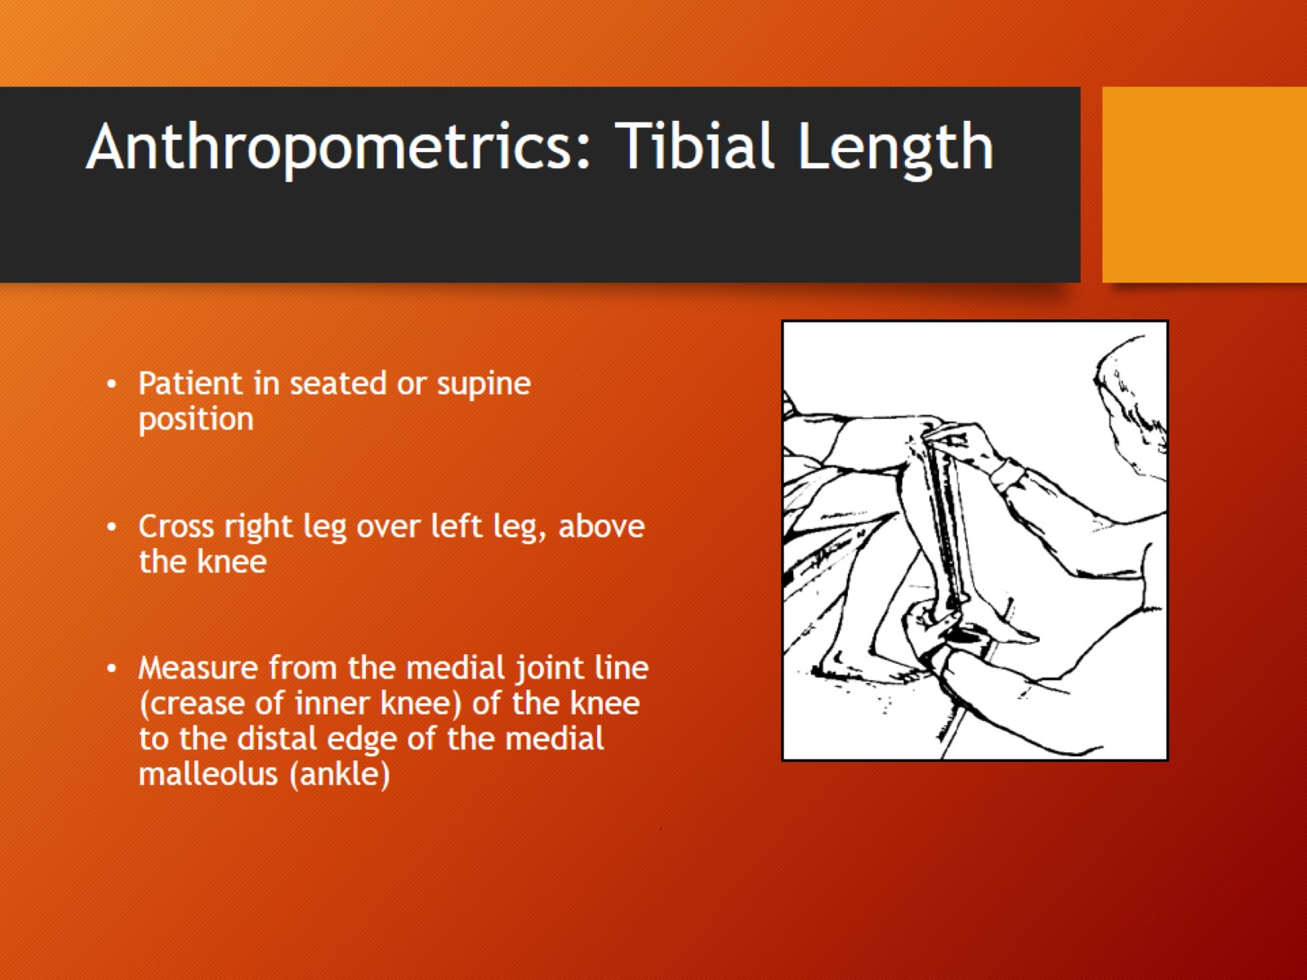
Anthropometrics: Tibial Length

Slide 53
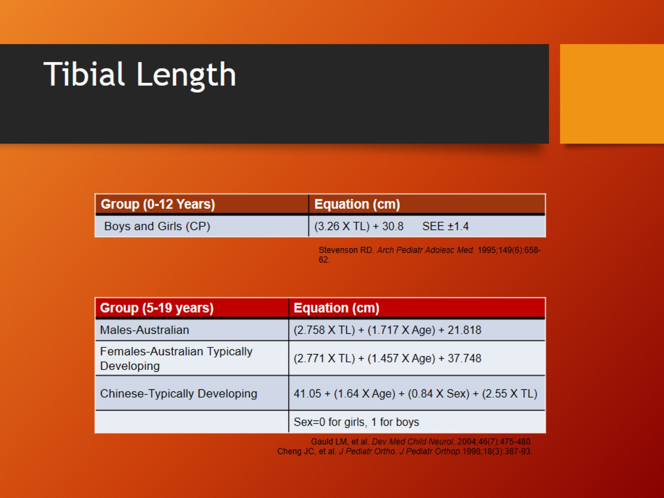
Tibial Length

Slide 54
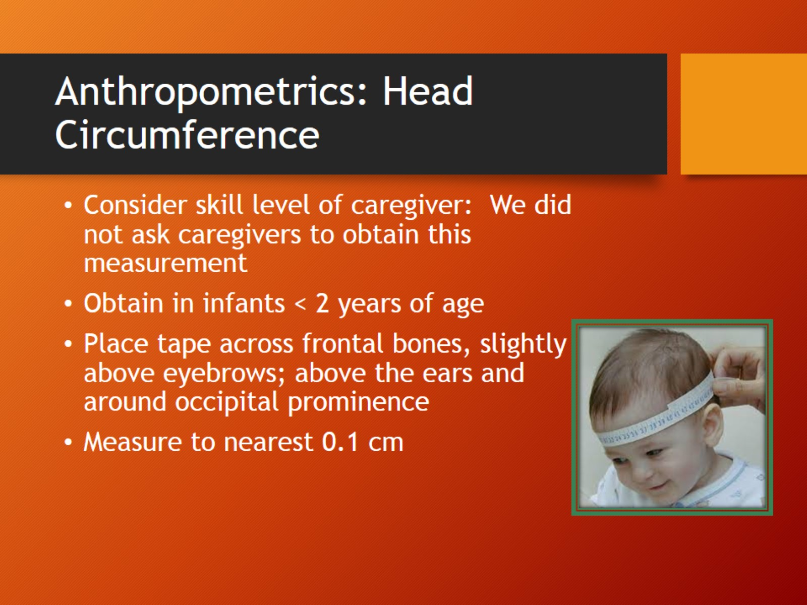
Anthropometrics: Head Circumference

Slide 55
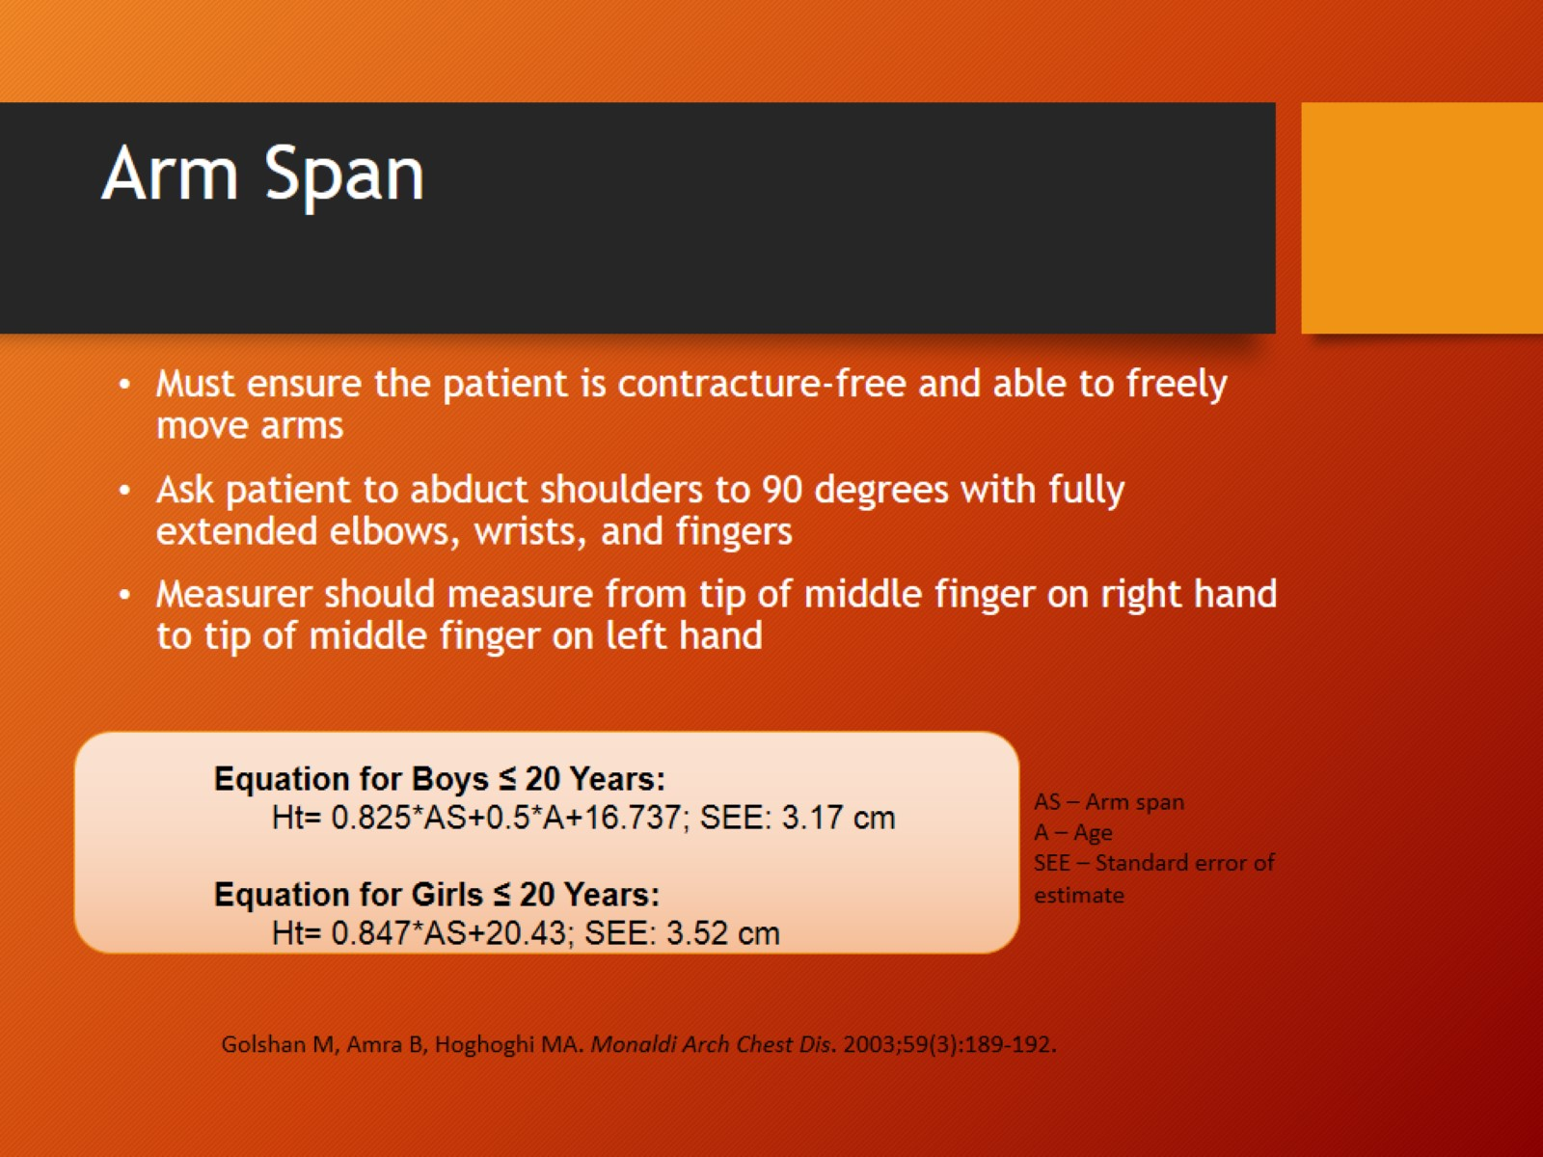
Arm Span

Slide 56
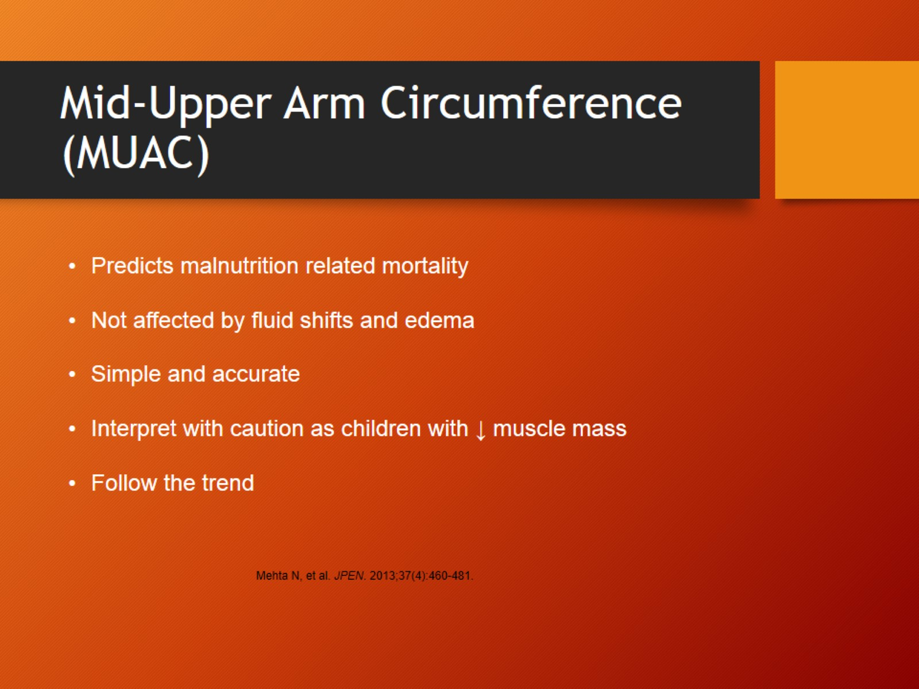
Mid-Upper Arm Circumference (MUAC)

Slide 57
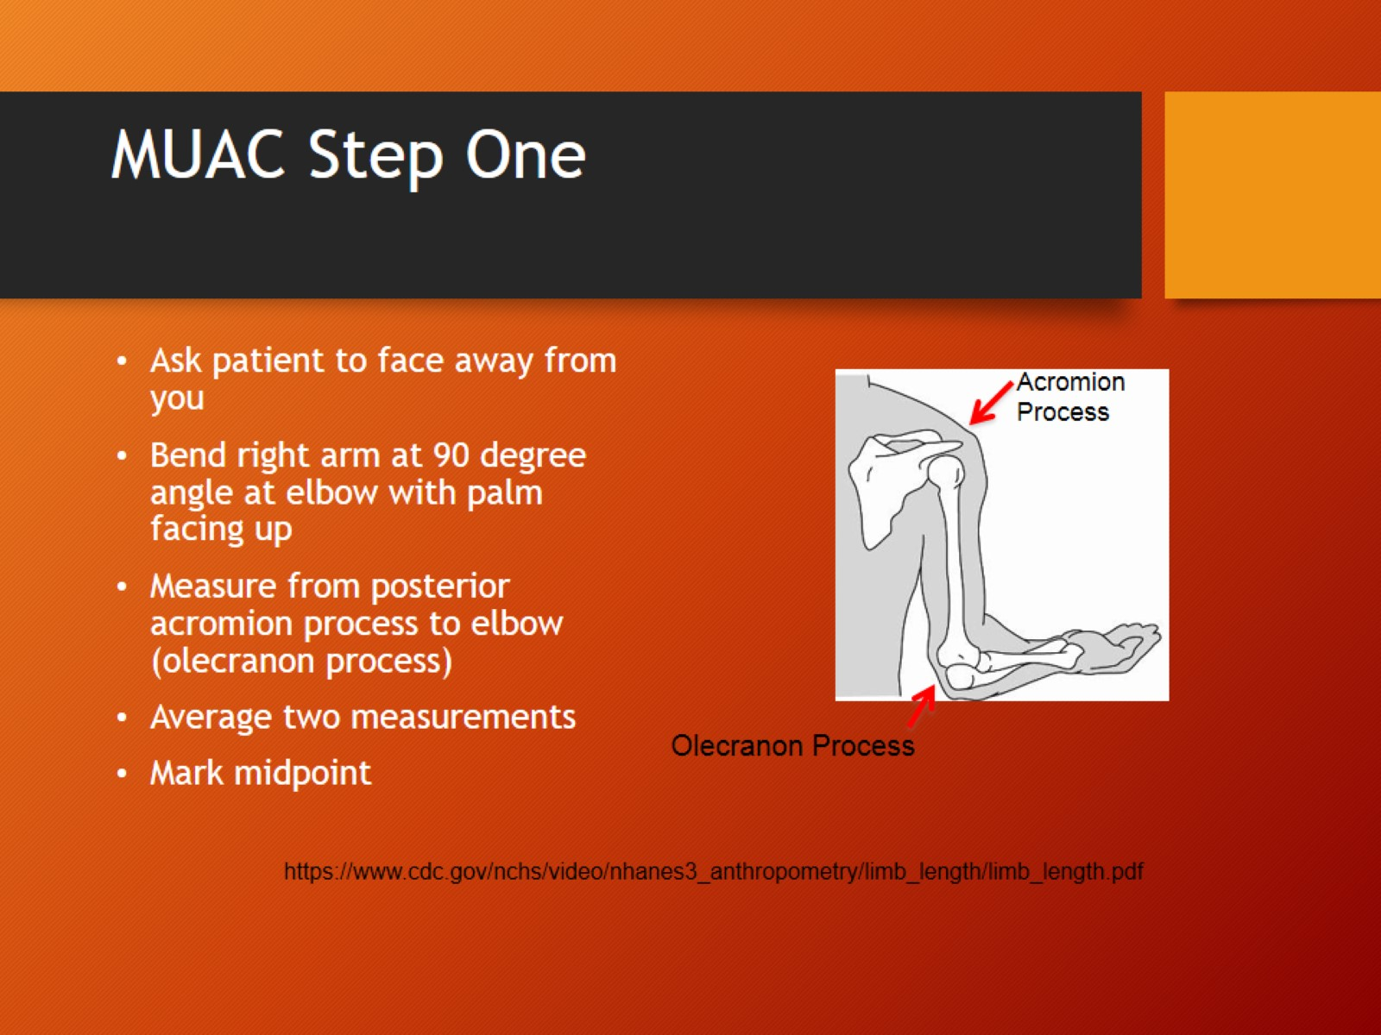
MUAC Step One

Slide 58
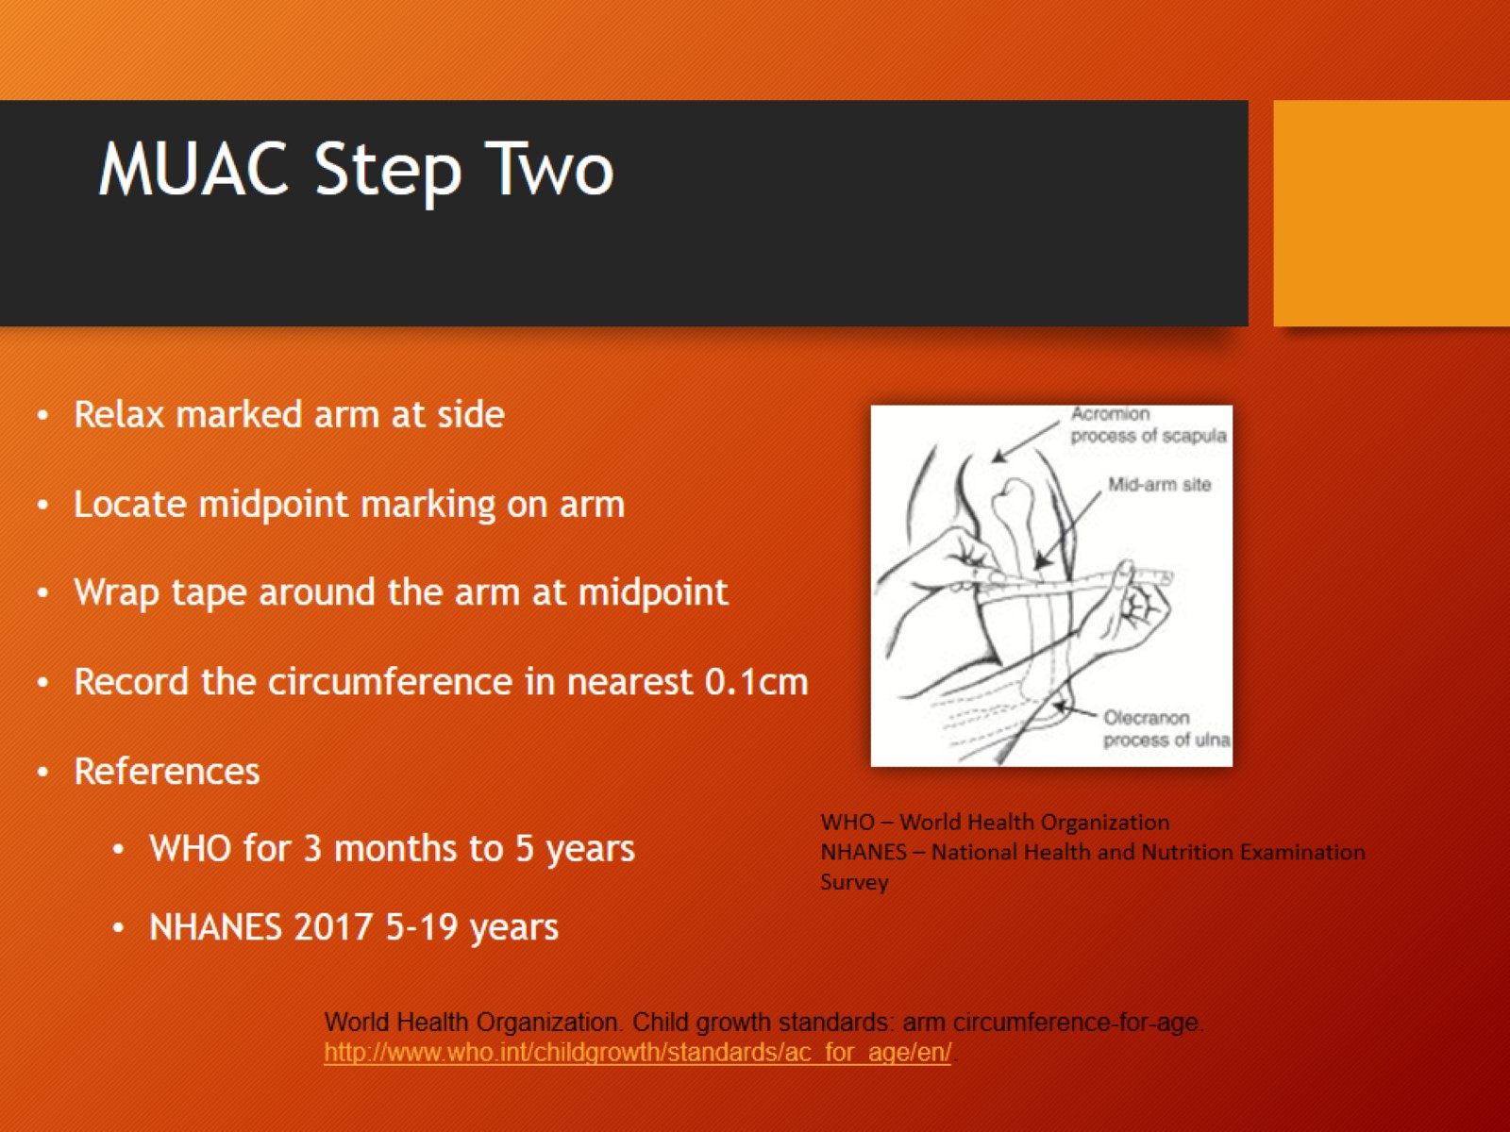
MUAC Step Two

Slide 59
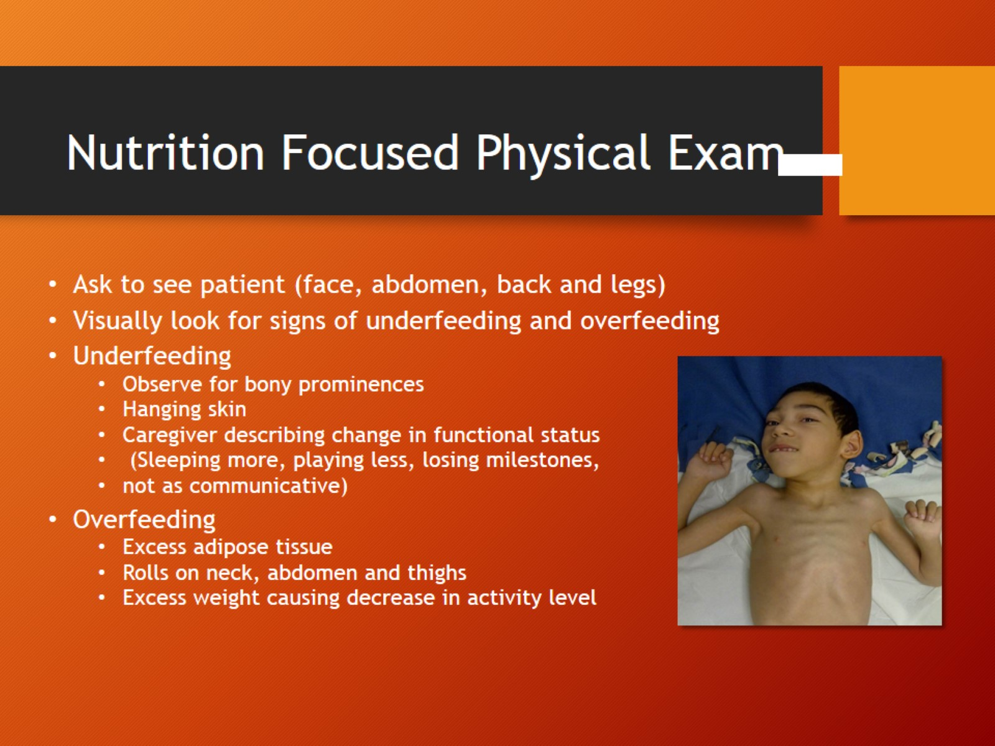
Nutrition Focused Physical Exam

Slide 60
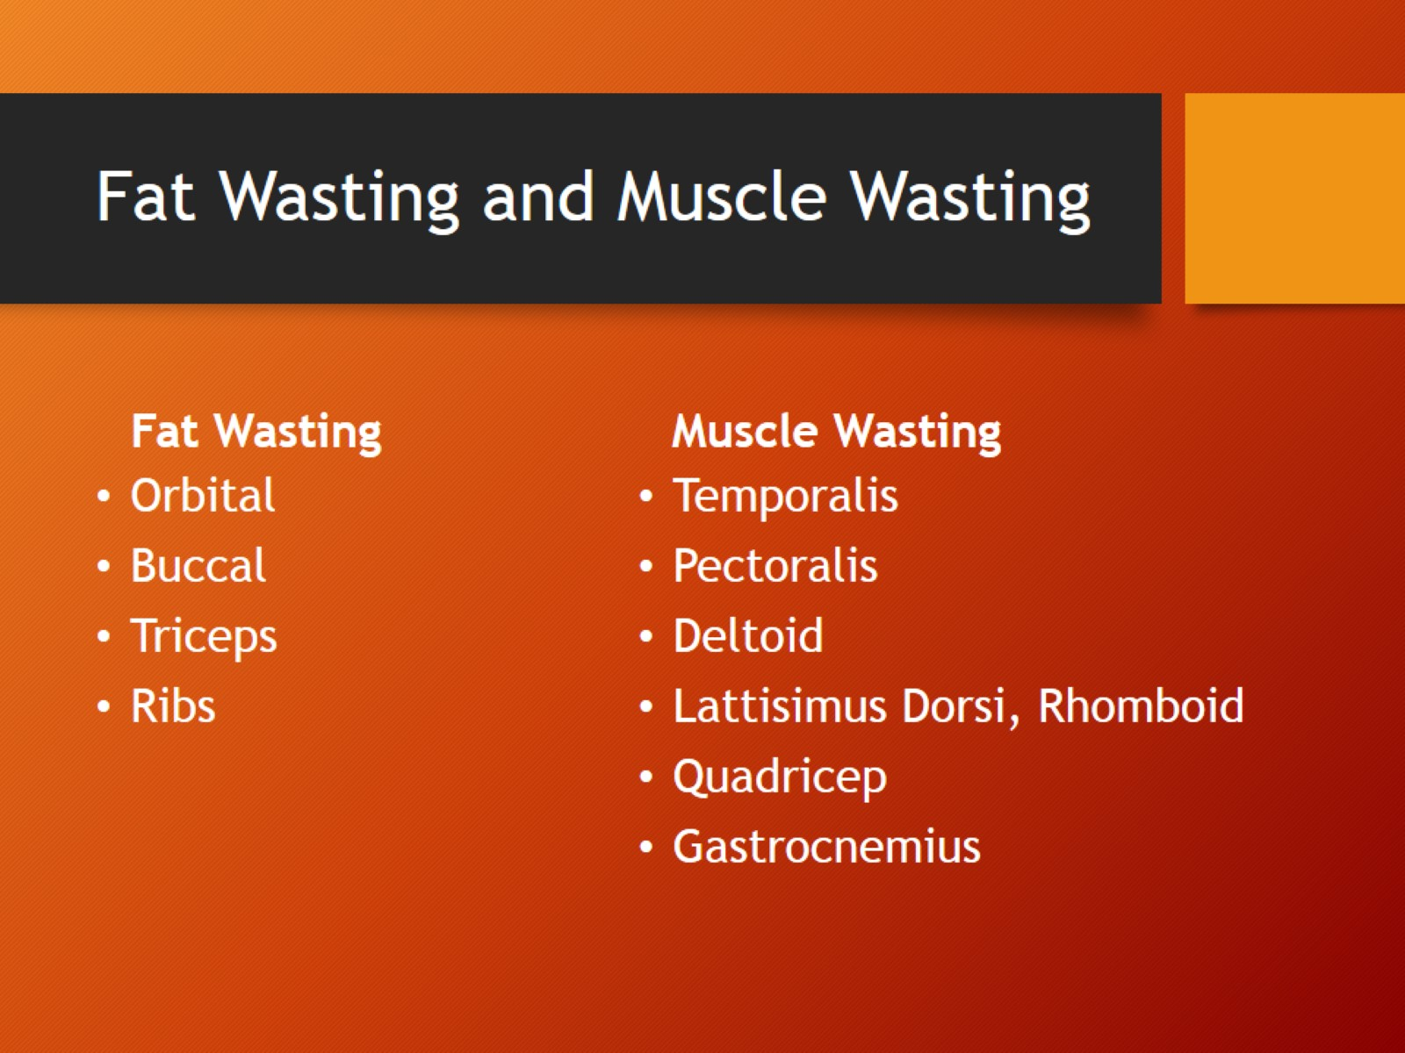
Fat Wasting and Muscle Wasting

Slide 61

Orbital Fat Loss

Slide 62

Buccal Fat Loss

Slide 63

Upper Body Fat Loss

Slide 64

Fat Loss/Ribs

Slide 65

Temporal Muscle Wasting

Slide 66

Upper Body Muscle Loss/Clavicle

Slide 67

Muscle Loss-Scapula

Slide 68

Muscle Loss/Shoulder

Slide 69

Lower Extremity Muscle Wasting

Slide 70

Lower Extremity Muscle Wasting

Slide 71

Nutrition Interventions

Slide 72

Take Away Points

Slide 73


